Slide 1
VOLUNTEERING AGED 14+
IN LOCAL GREEN SPACES

Slide 2
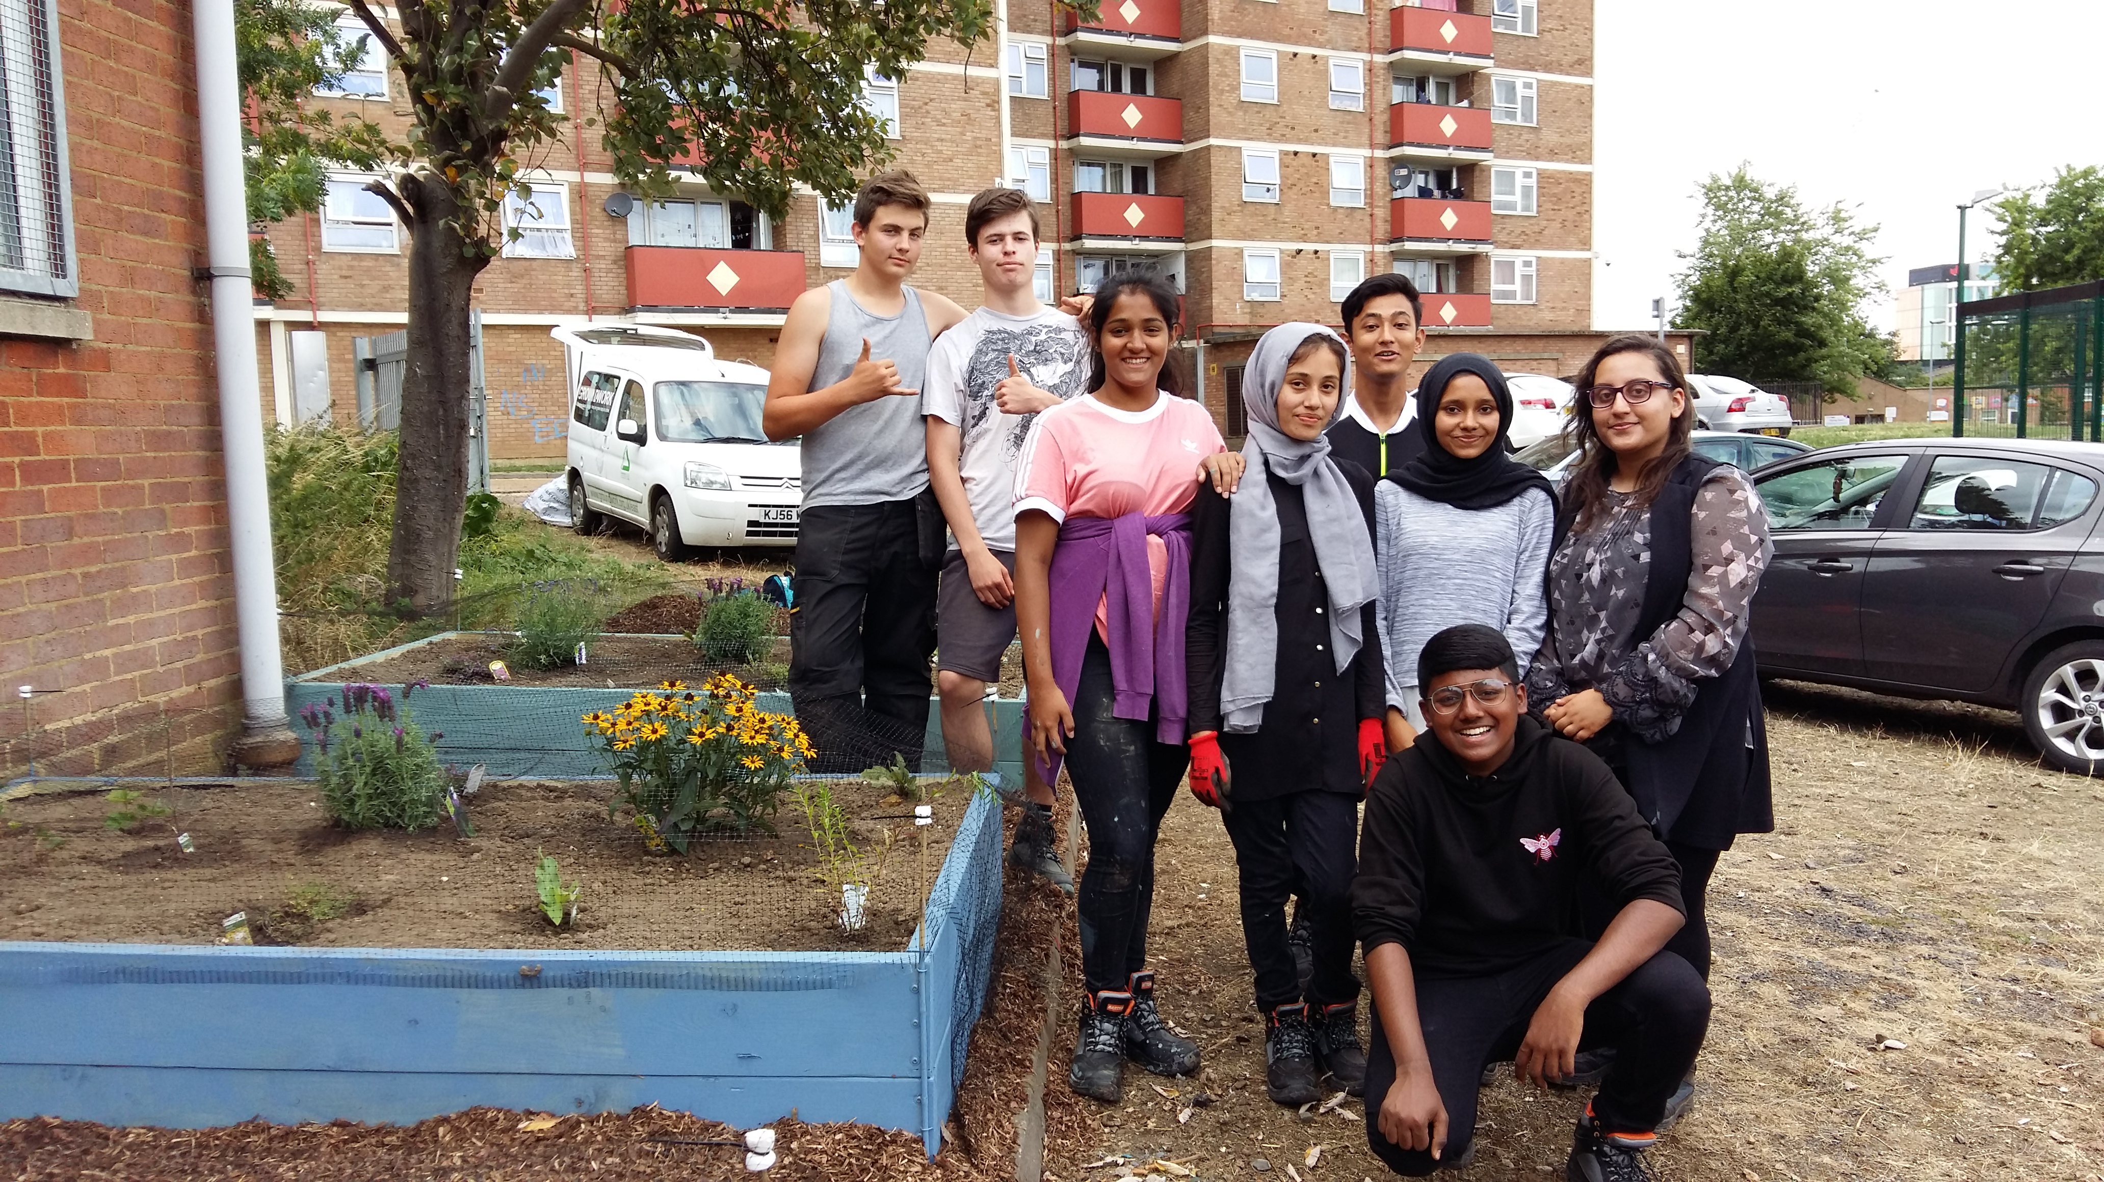
Parks and open spaces
Community spaces
A wide variety of volunteering opportunities
Benefit the local community
Benefit to nature
As well as learning new skills (or sharing existing ones!)
Notes:
Parks and open spaces are amazing spaces for the community. A large number of these parks operate volunteering opportunities. Voluntary activity in parks helps to improve the space for the local community with volunteer groups involved in conservation tasks, running events, fundraising and working with landowners to protect and enhance the space.

Slide 3
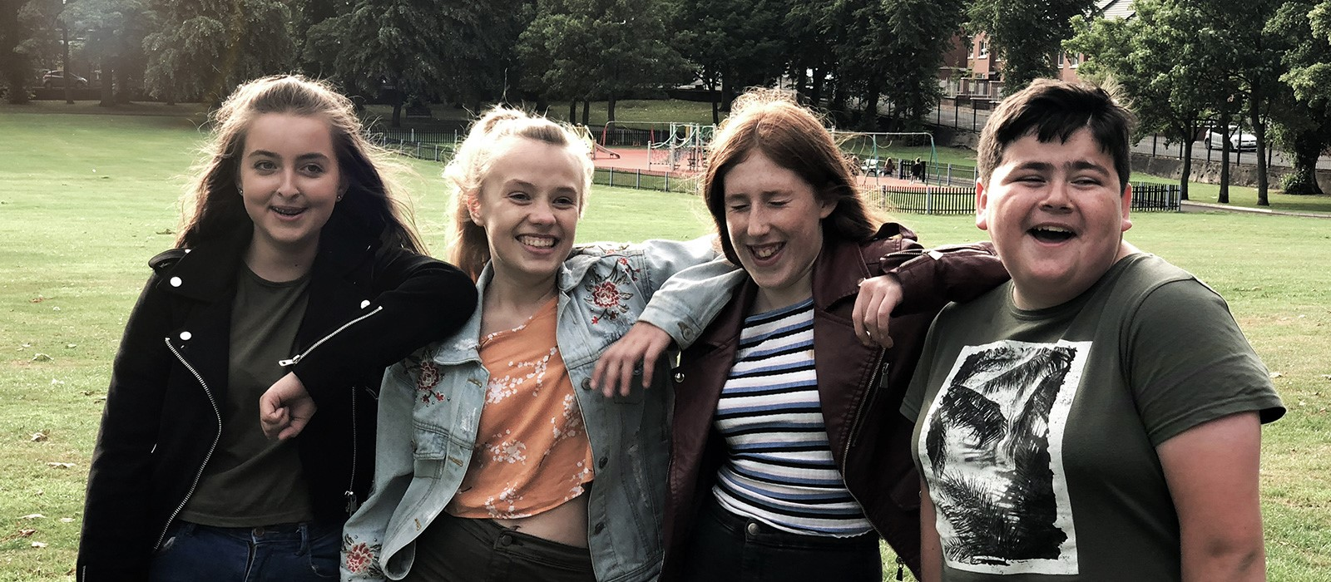
Future Proof Parks
A youth volunteering programme that has run over the last few years.
Increasing youth involvement.
Getting young voices heard.
Connecting young people with the environment.
Notes:
A youth volunteering programme, Future Proof Parks has been running for the past few years which has been increasing youth involvement and youth voice in local greenspaces. The programme has connected young people with environmental volunteering opportunities close to them and in their home towns.

Slide 4
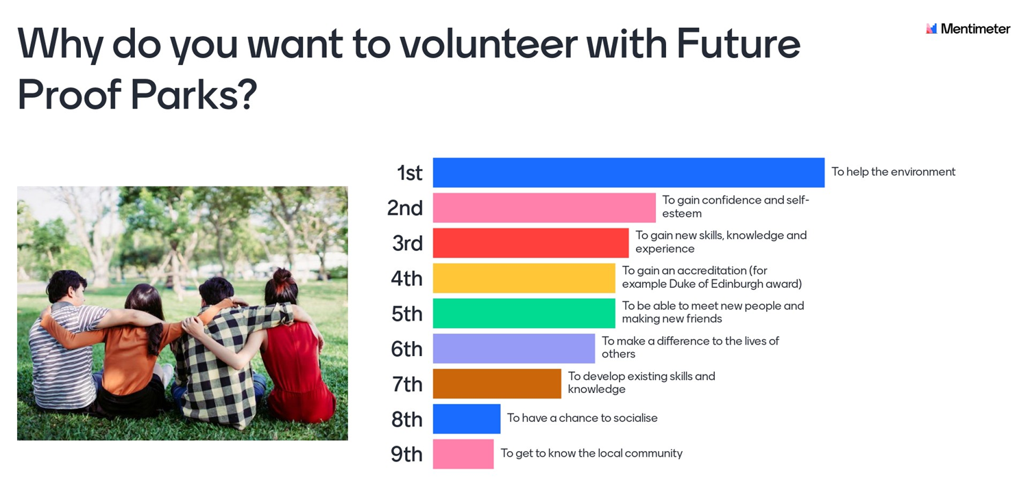
Notes:
Young people that took part in the project were asked what their reasons were for volunteering. A key reason was to help the environment but it also provided the young people with a number of other benefits, including teaching them new skills and giving them valuable experience.

Slide 5
Benefits of volunteering
give something back
make a difference to the lives of others
help the environment
help others less fortunate or without a voice
feel valued and part of a team
spend quality time away from normal / busy life
gain confidence and self-esteem
social gains.
Notes:
You may decide to volunteer for a variety of reasons, it may be as part of a programme at school (such as Duke of Edinburgh), to develop new skills, for experience. Whatever the reason, it provides an opportunity to: give something back to an organisation that has helped you, either directly or indirectly. Make a difference to the lives of others, help the environment, help others less fortunate or without a voice, feel valued and part of a team, spend quality time away from normal / busy life, gain confidence and self-esteem.
It also appeals because of its social benefits. These include: meeting new people and making new friends, a chance to socialise, get to know the local community.

Slide 6
Shaping a future career
gain new skills, knowledge and experience
develop existing skills and knowledge
Enhance your CV
improve employment prospects
as part of gaining an accreditation.
Notes:
Volunteering can also be a route to employment, or a chance to try something new. From this perspective, volunteering can be a way of: gaining new skills, knowledge and experience, developing existing skills and knowledge, enhancing your CV, improving employment prospects, or be part of gaining an accreditation.

Slide 7
What opportunities are available?
There are a range of opportunities available from event planning and decision making through to wildlife surveys and practical conservation tasks.
Opportunities for your local park are detailed on the next few slides. Volunteers of any age are welcome. Under 16’s need to be accompanied by an adult unless stated otherwise.
Notes:
There are a range of opportunities available from event planning and decision making through to wildlife surveys and practical conservation tasks.
Opportunities for your local park are detailed on the next few slides. Volunteers of any age are welcome. Under 16’s need to be accompanied by an adult unless stated otherwise.
Site specific opportunities detailed on next slides

Slide 8
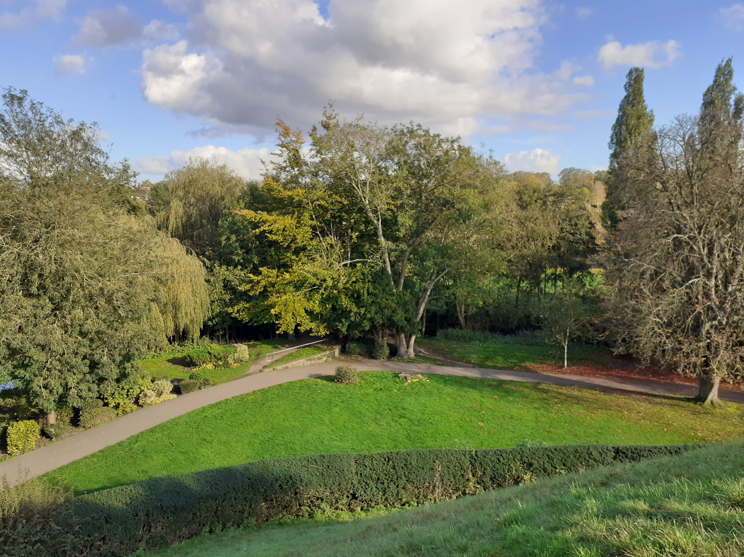
Castle Park, Bishop’s Stortford
To acknowledge its past, the park was recently renamed Castle Park and encompasses Castle Gardens and Sworders Field. Sat on top of a mound is the ruins of Waytemore Castle, built in the 11th Century by the Normans.
Prisoners were originally kept in the castle dungeon with Bishop’s prison built adjacent to the castle shortly after 1261. The park was privately owned land until 1907 when the council purchased the land for the town.
The Friends of Castle Park are a voluntary community group. They were set up in 2017 to ensure the local community has a voice in the management of the park.
Notes:
*DELETE SLIDE IF PARK IS NOT CLOSE TO YOUR STUDENTS*
Castle Park is in Bishop’s Stortford, Hertfordshire, CM23 2EL. To acknowledge its past, the park was recently renamed Castle Park and encompasses Castle Gardens and Sworders Field. Sat on top of a mound is the ruins of Waytemore Castle, built in the 11th Century by the Normans. Prisoners were originally kept in the castle dungeon with Bishop’s prison built adjacent to the castle shortly after 1261. The park was privately owned land until 1907 when the council purchased the land for the town.
The park is now managed and run by the local council. The Friends of Castle Park are a friendly volunteer group that welcome input from the whole community. They are keen to ensure that the park is a space for all local people to enjoy and they work closely with East Herts District Council and Bishop’s Stortford Town Council to do this.

Slide 9
Castle Park, Bishop’s Stortford
Volunteer groups run several activities that young people are welcome to get involved with:
Conservation Volunteering – monthly tasks, mixture of mid-week and weekend sessions.
Decision making – Friends group meet quarterly on Tuesday evenings to discuss the park, events & improvements needed.
Wildlife surveys – monthly riverfly surveys to survey insect species in the river.
Events – regular events throughout the year on different themes – wellbeing (July), wildlife (August) and heritage (Sept).
You can volunteer on your own from aged 16 with written consent from parent/guardian. Under 16’s are welcome to volunteer with an adult.
Notes:
*DELETE SLIDE IF PARK IS NOT CLOSE TO YOUR STUDENTS*
The Friends of Castle Park have several volunteering opportunities that young people are welcome to get involved with. Opportunities include:
Conservation volunteering – completing practical tasks to improve the space. Tasks can range from planting trees to litter picking and creating wildlife habitats.
Event planning – working with other volunteers to design, plan and run a range of community events.
Decision making – friends groups have regular meetings where they discuss the park and improvements needed.
To find out more and to sign up, visit: https://www.groundwork.org.uk/friends-of-castle-park-bishops-stortford/

Slide 10
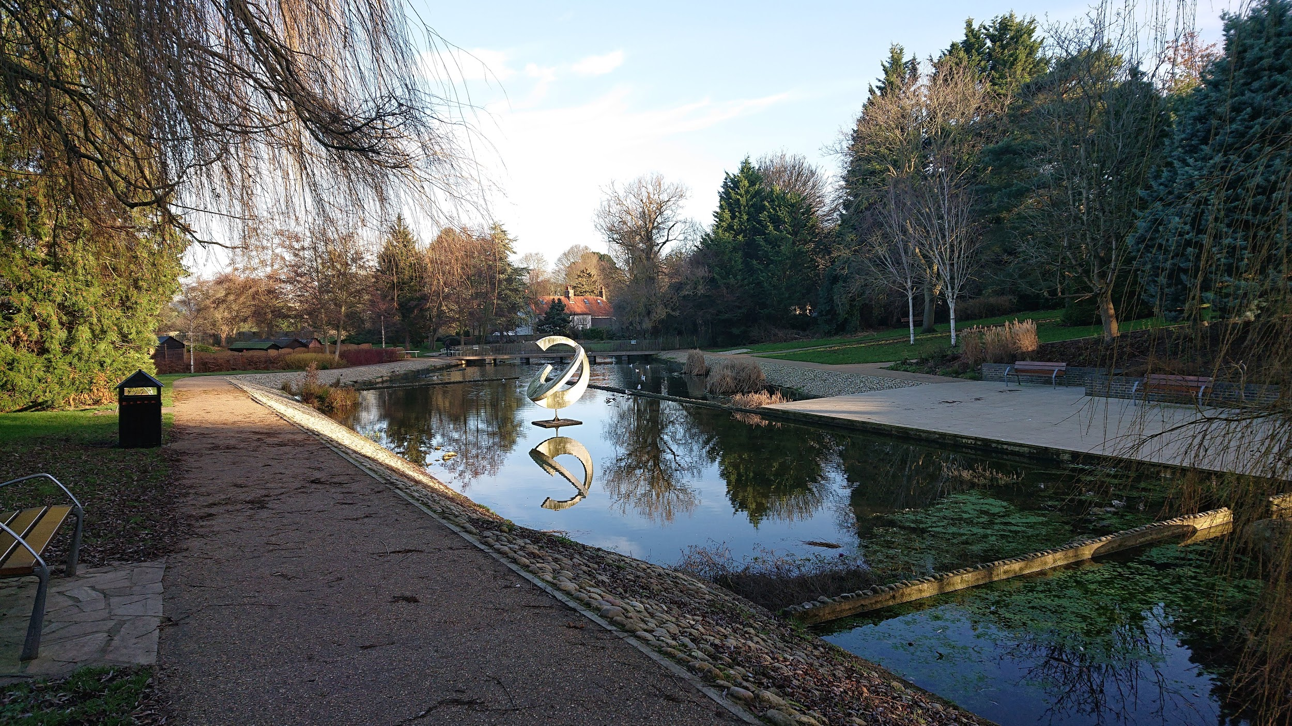
Harlow Town Park, Harlow
Harlow Town Park is a grade II listed site planned by Sir Frederick Gibberd and designed by landscape architect Dame Sylvia Crow. It officially opened in 1957. It is unusual for a public park to be given listed status, but the Town Park was considered significant because of its association with the new town and its picturesque planning.
Volunteers play a key role in the running of Harlow Town Park with a range of volunteer opportunities available.
Notes:
*DELETE SLIDE IF PARK IS NOT CLOSE TO YOUR STUDENTS*
Harlow Town Park is in Harlow, Essex, CM20 2QD. Harlow Town Park is a grade II listed site planned by Sir Frederick Gibberd and designed by landscape architect Dame Sylvia Crow. It officially opened in 1957. It is unusual for a public park to be given listed status, but the Town Park was considered significant because of its association with the new town and its picturesque planning.
Harlow Town Park is run by Harlow Council and there are numerous volunteer groups operating in the park, working closely with Harlow Council.

Slide 11
Harlow Town Park, Harlow
Volunteer groups run several activities that young people are welcome to get involved with:
Conservation Volunteering – weekly sessions (Tuesday’s & Thursdays) and monthly sessions (Saturday’s) with Harlow Council
Conservation Volunteering – fortnightly sessions with Harlow Conservation Volunteers (Sunday’s)
Decision making – Town Park User Group meet quarterly on Monday evenings to discuss the park & improvements needed.
Pets Corner - including working with the animals, helping with events and in the gift shop
Parkrun & Junior Parkrun – marshalling & timekeeping
You can volunteer on your own from aged 16 (aged 14 in Pets Corner). Under 16’s are welcome to volunteer with an adult.
Notes:
*DELETE SLIDE IF PARK IS NOT CLOSE TO YOUR STUDENTS*
There are several volunteer groups operating in Harlow Town Park to provide a great space for the community. The volunteer opportunities include:
Conservation volunteering – completing practical tasks to improve the space. Tasks can range from planting trees to litter picking and creating wildlife habitats.
Decision making – friends groups have regular meetings where they discuss the park and improvements needed.
Pets Corner – a range of volunteering opportunities are available in Pets Corner including working with the animals, helping to run events and working in the gift shop.
Parkrun & Junior Parkrun are run by volunteers. They are always happy to have more volunteers to help with setting up the course, marshalling and timing the run.
For most of these opportunities, you need to be aged 16 plus to volunteer on your own, except Pets Corner which is aged 14 plus. Those under 16 can volunteer for all these opportunities with an adult.
To find out more and to sign up visit: https://www.groundwork.org.uk/harlow-town-park-user-group-harlow/

Slide 12
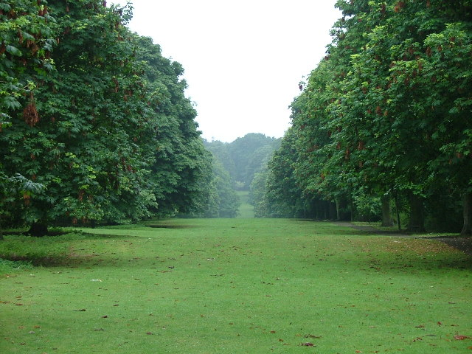
Norton Common, Letchworth
Norton Common is common land, owned by North Herts District Council where people have the right to roam. First enshrined in law in the Magna Carta in 1215, Common Land traditionally sustained the poorest people in rural communities who owned no land of their own, providing them with a source of wood, bracken for bedding and pasture for livestock. In 1898, Ebenezer Howard proposed the merging of town and country as a solution to the squalor and poverty of urban life in Britain. As the World's first Garden City, Letchworth’s public parks are treasured and maintained for public enjoyment.
The Friends of Norton Common are a volunteer group that works closely with the local council to make the common a space for all local people to enjoy.
Notes:
*DELETE SLIDE IF PARK IS NOT CLOSE TO YOUR STUDENTS*
Norton Common is in Letchworth, Hertfordshire, SG6 4UF. Norton Common is common land, owned by North Herts District Council where people have the right to roam. First enshrined in law in the Magna Carta in 1215, Common Land traditionally sustained the poorest people in rural communities who owned no land of their own, providing them with a source of wood, bracken for bedding and pasture for livestock. In 1898, Ebenezer Howard proposed the merging of town and country as a solution to the squalor and poverty of urban life in Britain. As the World's first Garden City, Letchworth’s public parks are treasured and maintained for public enjoyment.
The Friends of Norton Common are a friendly volunteer group that welcome input from the whole community. They are keen to ensure that the common is a space for all local people to enjoy and they work closely North Herts District Council to do this.

Slide 13
Norton Common, Letchworth
Volunteer groups run several activities that young people are welcome to get involved with:
Conservation Volunteering – weekly tasks, every Thursday morning
Decision making – Friends group meet quarterly to discuss the common & improvements needed.
Wildlife surveys – volunteers run a range of surveys including bat & butterfly surveys
You can volunteer on your own from aged 16 with written consent from parent/guardian. Under 16’s are welcome to volunteer with an adult.
Notes:
*DELETE SLIDE IF PARK IS NOT CLOSE TO YOUR STUDENTS*
The Friends of Norton Common have several volunteering opportunities that young people are welcome to get involved with. Opportunities include:
Conservation volunteering – completing practical tasks to improve the space. Tasks can range from planting trees to litter picking and creating wildlife habitats.
Event planning – working with other volunteers to design, plan and run a range of community events.
Decision making – friends groups have regular meetings where they discuss the park and improvements needed.
Find out more: www.groundwork.org.uk/friends-of-norton-common-letchworth

Slide 14
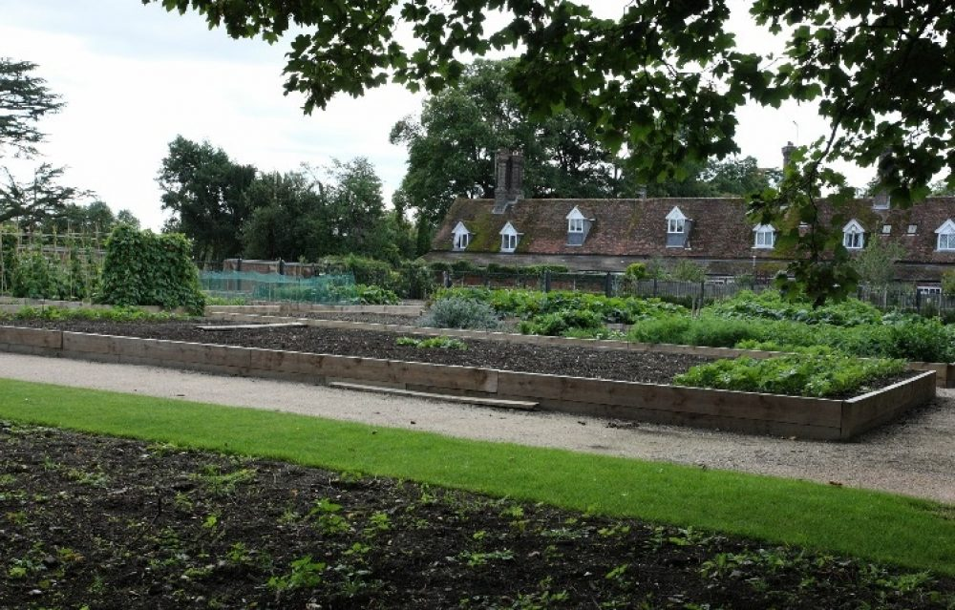
Houghton Hall Park, Houghton Regis
Locally Houghton Regis is famous for Houghton Hall (listed as an ancient monument), which was built for Dame Alice Milard in 1654 and completed in 1700. The Hall, an important landmark overlooking Houghton Hall Park, is no longer a private residence and is now privately owned. Part of the park includes the kitchen gardens, an area of land dedicated to the growing of herbs and vegetables that would have served the house.
Volunteers play a key role in the running of Houghton Hall Park with a range of volunteer opportunities available.
Notes:
*DELETE SLIDE IF PARK IS NOT CLOSE TO YOUR STUDENTS*
Houghton Hall Park is in Houghton Regis, Central Bedfordshire, LU5 5FU. Locally Houghton Regis is famous for Houghton Hall (listed as an ancient monument), which was built for Dame Alice Milard in 1654 and completed in 1700. The Hall, an important landmark overlooking Houghton Hall Park, is no longer a private residence and is now privately owned. Part of the park includes the kitchen gardens, an area of land dedicated to the growing of herbs and vegetables that would have served the house.
The Friends of Houghton Hall Park are a friendly volunteer group that welcome input from the whole community. They are keen to ensure that the park is a space for all local people to enjoy and they work closely with Central Bedfordshire Council to do this.

Slide 15
Houghton Hall Park, Houghton Regis
Volunteer groups run several activities that young people are welcome to get involved with:
Conservation Volunteering – monthly tasks (Sunday)
Events – regular events throughout the year on different themes - Kitchen Garden Monster trail (July),Treasure Island Trail (Aug), Arbor Day (Aug), Dog Festival (Sept). Young people are welcome to help with designing and planning activities for these events, and/or help run the activity on the day.
You can volunteer on your own from aged 16. Under 16’s are welcome to volunteer with an adult.
Notes:
*DELETE SLIDE IF PARK IS NOT CLOSE TO YOUR STUDENTS*
The Friends of Houghton Hall Park have several volunteering opportunities that young people are welcome to get involved with. Opportunities include:
Conservation volunteering – completing practical tasks to improve the space. Tasks can range from planting trees to litter picking and creating wildlife habitats.
Event planning – working with other volunteers to design, plan and run a range of community events.
Find out more: www.groundwork.org.uk/the-friends-of-houghton-hall-park-houghton-regis

Slide 16
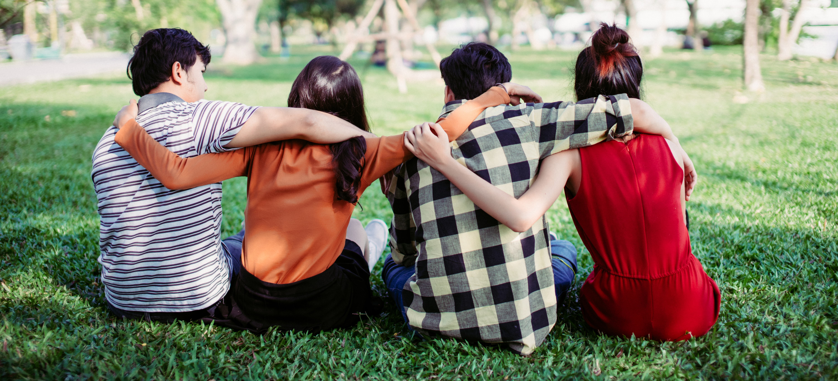
Find out more
Bishop’s Stortford: www.groundwork.org.uk/friends-of-castle-park-bishops-stortford
Harlow: www.groundwork.org.uk/harlow-town-park-user-group-harlow
Houghton Regis: www.groundwork.org.uk/the-friends-of-houghton-hall-park-houghton-regis
Letchworth Garden City: www.groundwork.org.uk/friends-of-norton-common-letchworth
Notes:
If you are interested in finding out more about volunteering in your local park or greenspace, please visit the following website to read more about the opportunities and to sign up!

