Slide 1
GROUNDWORK
CHANGING PLACES CHANGING LIVES
Notes:
Groundwork London is a charity which works with communities and schools to improve people’s lives and their environment.

Slide 2
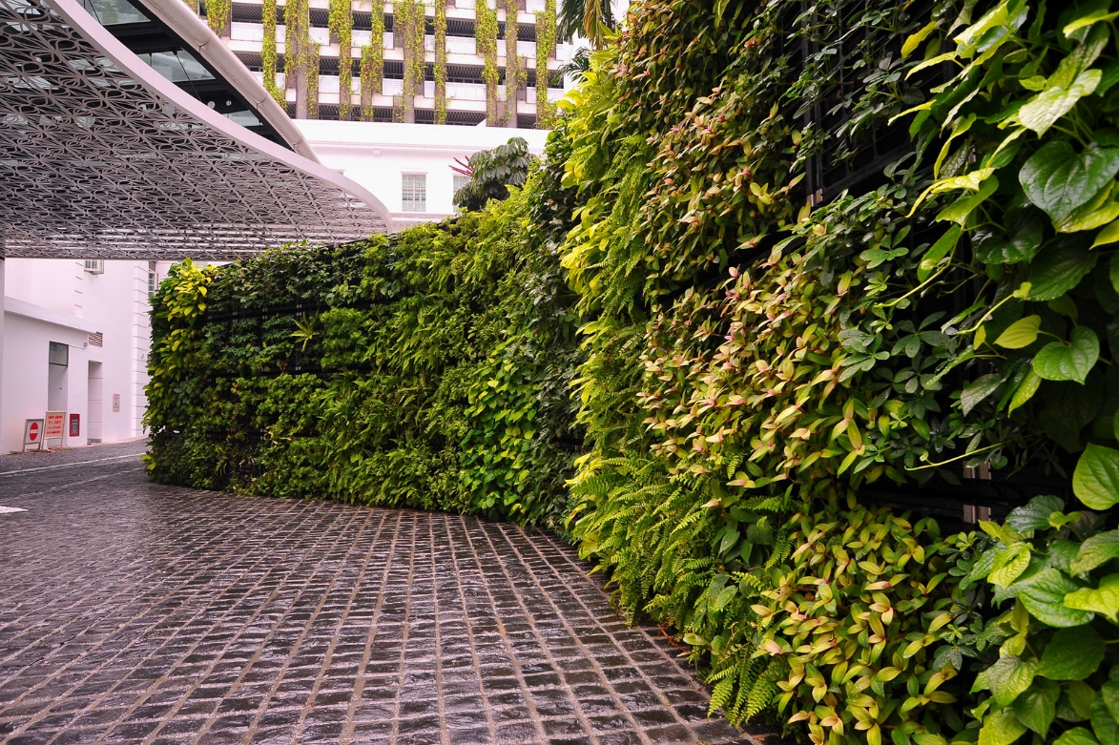
Notes:
Groundwork London work with London primary schools to improve the air quality in and around schools.
This is an example of a green wall in a school which improves air quality.

Slide 3
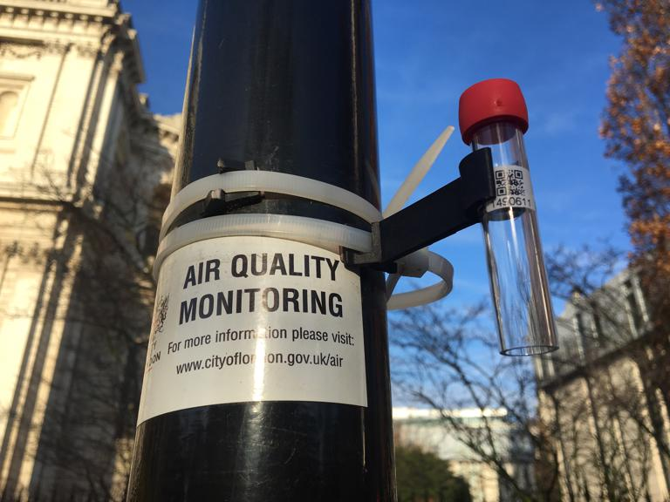
Notes:
Put your hand up of you’ve seen one of these before. I wonder if anyone knows what it is for – can anybody have a guess?

Slide 4
This is a diffusion tube. It measures a kind of pollution – nitrogen dioxide – which is bad for our health.

Slide 5
Now take a deep breath…
Notes:
Take a deep breath. In a single intake of air, your lungs swell with roughly 25 sextillion molecules, ranging from days-old compounds, to those formed billions of years in the past. In fact, many of the molecules you’re breathing were likely exhaled by members of ancient civilizations.
That’s right – we all share the same air. In fact, having access to clean air is one of your human rights.

Slide 6
Gases
Particles
What is air pollution?
Notes:
Air pollution is a term that describes the harmful gases and particles in the air. It is often produced by road transport or burning wood. These gases can affect the quality of the air around us and cause us health problems.
Any amount of pollution can be damaging to our health, but the more that you are exposed to, the bigger the risk and the larger the impact it can have.

Slide 7
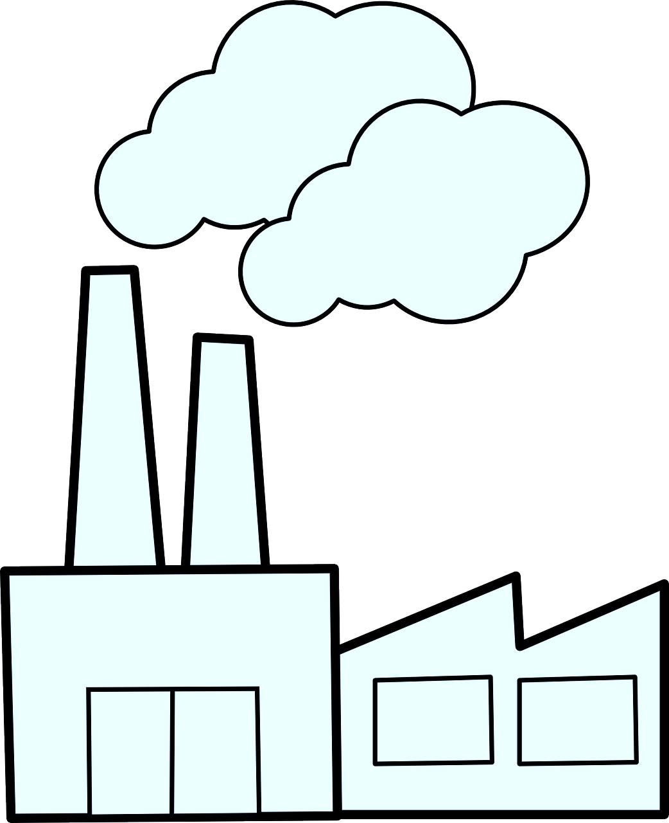
Where does air pollution come from?
Notes:
Road transport is estimated to be responsible for about 50% of nitrogen oxide emissions in London. 30% comes from wood burning or heating.

Slide 8
What keeps the air clean?
Notes:
Plants clean the air through the process of photosynthesis. As humans breathe in oxygen and breathe out carbon dioxide, plants do the opposite. They absorb light, carbon dioxide, and water to manufacture sugar. This chemical process creates oxygen as a byproduct. They can also trap particles on their leaves.
As a raindrop falls through the atmosphere, it can attract tens to hundreds of tiny aerosol particles to its surface before hitting the ground. The process by which droplets and aerosols attract is coagulation, a natural phenomenon that can act to clear the air of pollutants like soot, sulfates, and organic particles.

Slide 9
Source | Shoulders
Solution | Head
Notes:
In this game, you will be shown some pictures. If the picture shows a source (emitter) of pollution, touch your shoulders. If the picture shows a solution to pollution (combats pollution), touch your head.

Slide 12
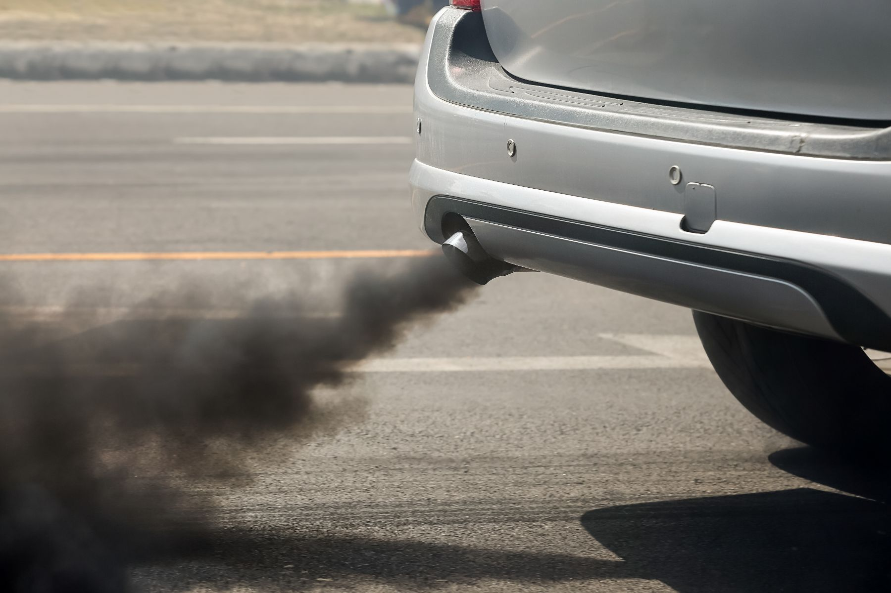

Slide 14
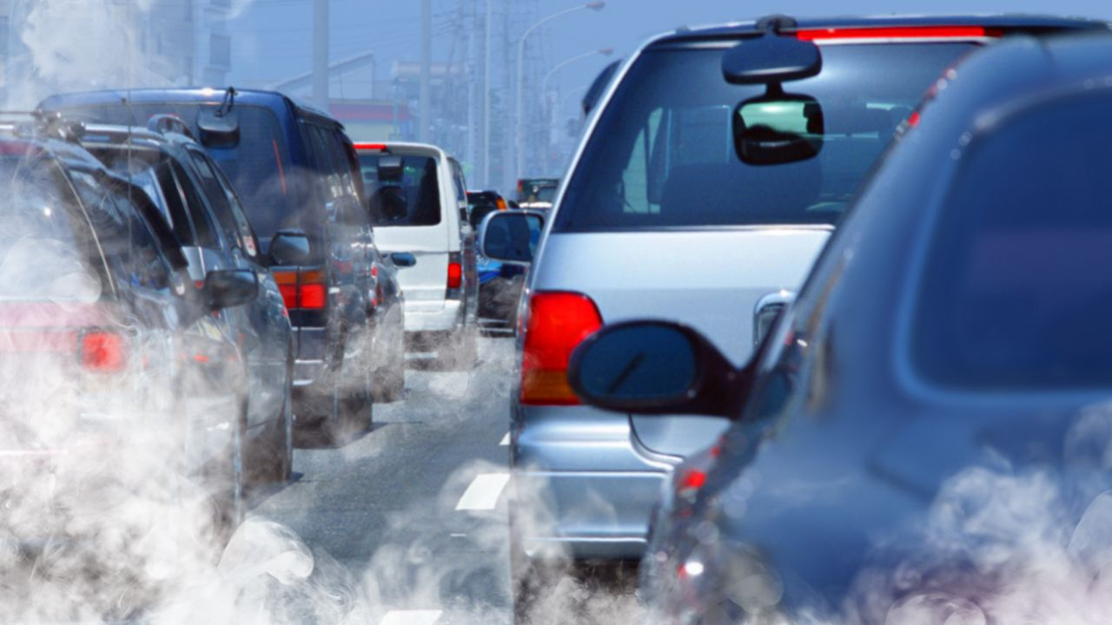

Slide 16
What can we do about it?
Walk, cycle, scoot or take public transport
Discover the side streets – use quieter streets and avoid main roads
Think about your transport – take the bus, share a ride or switch to an electric car
Plant a tree
Notes:
We all have the power to do something to lessen pollution.
When you’re out and about, look around you and notice both negative impacts and positive impacts on air quality in your route to school. You may be amazed at what you might notice!

