Slide 1
Hong Kong Empowerment Fund
6th March 2024 12noon-2pm

Slide 2
Agenda
Background of the Hong Kong BN(O) visa scheme, DLUHC’s Hong Kong BN(O) Welcome Programme and GLA’s Hong Kong Integration Programme
Introduction to Groundwork London
Introduction to the Hong Kong Empowerment Fund
Application process and tips
Hong Kong Empowerment Fund programme key dates
Q&A in English
Drop-in session in Cantonese (in a separate breakout room to start at 1:15pm)
This meeting will be recorded, apart from the Q&A section.

Slide 3
Background of hk BN(O) Visa Route
July 2020
China’s imposition of the National Security Law on the people of Hong Kong
31 Jan. 2021
New immigration route was introduced for Hong Kong British National (Overseas) status holders
2022
The Hong Kong Welcome Programme was launched.
Nov 2022
The BN(O) visa scheme was expanded
Notes:
Following China’s imposition of the National Security Law on the people of Hong Kong in July 2020, the UK government introduced a new immigration route on 31 January 2021 for Hong Kong BN(O) status holders, providing them and their family members with the opportunity to live, work and study in the UK. The visa scheme was expanded in November 2022 to allow adult children of BN(O) status holders to apply to the route independently from their BN(O) parents. According to the government’s immigration statistics1 published on 23 November 2023, there have been a total of 190,997 applications for the BN(O) route since its introduction up to the end of September 2023, out of which 184,700 people have been granted the visa and 135,400 people have already arrived in the UK.
While it is difficult to know the exact number of BN(O)s residing in different areas across the country, estimates and research findings have shown that London is one of the most popular locations where BN(O)s choose to live in the UK. According to a survey conducted by Hongkongers in Britain in 20212, and a nation-wide study conducted by the University of Liverpool in 20223, between 22.2% and 23.5% of BN(O)s arriving in the UK may choose to reside in London. Many living outside of London may commute to the city for work, education or community spaces.

Slide 4
Background DlUHc’s Hk BN(O) welcome programme
Demand-led English language and destitution funding support for Local Authorities
Nationally and regionally funded voluntary, community and social enterprises (VCSEs)
Funding support for reporting services for BN(O)s who experience racism or any forms of hate
Network of 12 ’Hong Kong Welcome Hubs’ across the whole of UK
Online welcome pack for BN(O)s
Hong Kong Welcome Programme, led by the Department of Levelling Up, Housing and Communities (DLUHC)
See here for more information
Notes:
To support new arrivals on the BN(O) route to successfully settle in their new communities the UK, in 2022 the Government launched “Hong Kong Welcome Programme” led by the Department for Levelling Up, Housing and Communities (DLUHC). The Welcome Programme includes several key elements:
Demand-led funding for Local Authorities in England to support BN(O) status holders and their families with English language and destitution support. The amount of English learning support is currently set at £850 per adult per financial year, and claims can be made for both accredited and non-accredited English classes. (For more information on how to claim demand-led funding please see more information here);
An online Welcome Pack providing information on how to access services and understand life in the UK;
Nationally and regionally funded voluntary, community and social enterprises (VCSEs) to deliver support and activities for social integration (List of funded organisations in 2023/2024);
Funding for reporting services for BN(O)s who experience racism or any forms of hate.
A network of 12 “Hong Kong Welcome Hubs” across the whole of the UK to prepare for the arrival of the BN(O)s, established using the existing infrastructure of the Strategic Migration Partnerships; The London Hongkong Welcome Hub sits within Greater London Authority.

Slide 5
Background of GLA’s Hk Integration Programme
Year 1: Welcoming Hongkongers Fund
Year 2: Hong Kong Community Fund
Year 3: Hong Kong Empowerment Fund
Year 3 of GLA’s Hong Kong Integration Programme has already begun.
All our funded projects must be delivered and completed in November 2024.

Slide 6
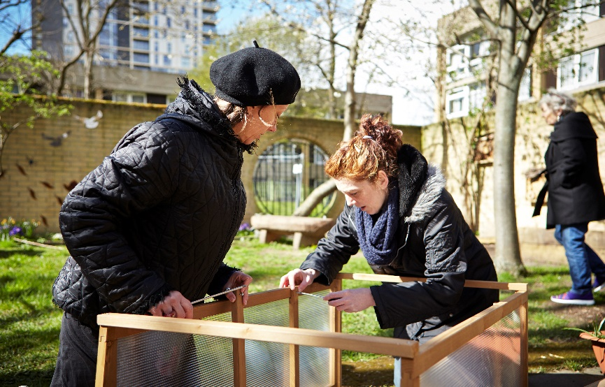
WHO IS GROUNDWORK london?
Groundwork London is an environmental and social regeneration charity, working closely with communities.
We work under three interlocking themes:
  Creating better spaces
  Greener Living and Working
  Improving People's Prospects
Notes:
Groundwork – Is a environmental and social regeneration charity, working closely with communities.
We work under three interlocking themes:
Creating better spaces
Last year, and through our grant programmes, we improved 200 hectares of land and planted 18,000 trees
Greener Living and Working
We saved £12m from domestic fuel bills and gave a second life to 315 tonnes of household goods.
Improving People's Prospects
We coached over 500 young people and provided over 800 qualifications to adults.

Slide 7
GLA and Groundwork London
The GLA and Groundwork London are collaborating closely on this fund.
Groundwork London | GLA
Support during application stage | Support should your application be successful
Provide capacity, support and consultation | First point of contact during your grant journey, if your application is successful
Provide support to potential applicants, including technical assistance | Contact successful applicants to agree on project delivery dates and goals prior to signing Grant Agreement
Both Groundwork London and GLA will work together to answer as many of your questions as possible.
Pre-election period starts on 19/3/24 and there will be limitations to our ability to respond to queries directly.
Notes:
Both Groundwork London and GLA will work together to answer as many of your questions as possible. We will also keep the Hong Kong Empowerment Fund webpage updated to provide as much supporting information as possible.
Please note: the Mayoral election in London takes place on 2nd May 2024 and the pre-election period starts on 19th March 2024. Because of this, there will be limitations to the ability of Groundwork London and GLA to respond to queries directly. Therefore, if any applicants have questions, please contact us by 18th March 2024, so we can respond to your questions as best as we can.
From 19th March 2024 onwards, only technical questions (e.g. how to submit your application on BBGM) will be answered.

Slide 8
Introduction to the HK Empowerment Fund
Eligibility criteria
Types of grants available
Application process and tips

Slide 9
Eligibility criteria
For both Growth and Collaboration grant
Applying organisations should be equity led
Please see Programme Prospectus p. 10 for the definition of equity led
Project activities should meet at least one of the HKEF aims
Please see Programme Prospectus p.5-7 for more details.
All activities should be delivered in London.
Activities should be delivered within 6 months. All activities should be completed by November
All proposed projects ideally should be community-led.
Notes:
Equity-led means at least 75% of the organisation’s Trustees and 50% of the staff members having lived experience of the issues they seek to address through their proposed projects. Example: a group that advocates for rights of migrant women who has 75% of trustees and 50% of staff from women migrant backgrounds.
Meet one of more of the HKEF aims please refer to HKEF programme prospectus p. 5-7.
Community-led: This means the design, planning and/or delivery should involve the people that the group/organisation serves and supports.
This element can be elaborated in the application by explaining how the applicant has consulted the BN(O) community to identify the need, design relevant interventions and/or involve BN(O) individuals in project delivery. It could also include elaboration of previous experience working with the BN(O) community. The consultation process prior to application submission does not need to be formal and should not be part of your project plan. However, it is essential that projects reflect the priorities of the community.

Slide 10
Types of grants available – growth grant
Up to £15,000
Open to non-established and newly established groups or organisations run by and/or for Hongkongers and their partners.
For organisations that are not legally constituted, you must have a sponsor organisation.
All application organisations or sponsor organisations must have at least two Trustees/Directors/Management Committee members who are not related and have a charitable dissolution clause within their governing document.

Slide 11
sponsor organisation requirements (Growth Grants)
Should fulfil at least one of the following criteria:
Receive the money on behalf of the un-constituted group.
Be responsible for the grant funding terms and will need to jointly sign the grant agreement.
Have adequate and appropriate policies and procedures in place (Safeguarding, insurance, Equality& Diversity, etc).
Support the non-constituted group (policy adherence, meetings with GLA).
Registered charity | Charitable Incorporated Organisations (CIO)
Charitable Company (limited by guarantee) | Charitable Company (limited by guarantee)
Community Amateur Sports Club | Community Benefit Society
Excepted or exempted charity | Community Interest Company (CIC)
Notes:
Sponsor organisations should :
Agree to accept the money on behalf of the unconstituted group and will pay out the fund from their own bank account;
Be responsible for the grant funding terms and will need to jointly sign the grant agreement with the GLA and the unconstituted project delivery group;
Have adequate and appropriate policies and procedures in place, including policies for Safeguarding, insurance, Equality, Diversity and Inclusion (EDI) and complaints (where services include advice provision);
Support the non-constituted group to ensure their project delivery adheres to the sponsor’s policies and procedures. This may also include attending meetings with GLA grants officer.

Slide 12
Types of grant available – collaboration grant
Up to £50,000
Available to two or more organisations working in collaboration and partnership.
A lead partner must be identified in the application, and this must be a legally constituted group.
Applicants should provide a clear and detailed outline of how roles and resources will be divided and allocated amongst partnering organisations.
All groups and organisations involved in the partnership project should agree and sign the application form.
Notes:
Lead organisations should be a constituted group and fulfil one of the following criteria:
Registered Charity
Charitable Incorporated Organisations (CIO)
Community Interest Company (CIC)
Charitable Company (limited by guarantee)
Constituted Group/Organisation
Excepted or exempted charity
Community Amateur Sports Club
Community Benefit Society

Slide 13
Application process and tips

Slide 14
Application links
Groundwork London Hong Kong Empowerment Fund webpage – please see here
Hong Kong Empowerment Fund Programme Prospectus – please see here
Application questions in MS Word version – please note that all submissions must be made directly in BBGM Portal.
        Growth Grant
Application-Questions-Growth-Grant-HKEF.docx (live.com)
Application-Questions-Collaboration-Grant-HKEF.docx (live.com)
Application Links to the BBGM Portal:
https://www2.grantrequest.co.uk/application.aspx?sid=123&fid=35516
https://www2.grantrequest.co.uk/application.aspx?sid=123&fid=35519
Notes:
In our website you will be able to locate the Programme prospectus which contains important information about the grants and the application process.
You will also be able to review both application forms for the Collaboration and the Growth grants, as we have both uploaded in Word Document. This way you and your partners will be able to have a look at the forms questions and potentially prepare your answers.
Please bear in mind that we only approve applications submitted via our BBGM Platform.
In general we recommend you access the BBGM Platform using Microsoft Edge or Firefox as these browser work the best with the functional settings of BBGM.
Please find below our application links here

Slide 15
Application links
Groundwork London Hong Kong Empowerment Fund webpage – please see here
Hong Kong Empowerment Fund Programme Prospectus – please see here
Application questions in MS Word version – please note that all submissions must be made directly in BBGM Portal.
  Growth Grant
  Collaboration Grant
Website links to application forms on BBGM:
  Growth grant – please click here
  Collaboration Grant – please click here
We recommend using Microsoft Edge or Mozilla Firefox browsers to access BBGM as users have reported minor issues when using other browsers.
Notes:
- In our website you will be able to locate the Programme prospectus which contains important information about the grants and the application process.
- You will also be able to review both application forms for the Collaboration and the Growth grants, as we have both uploaded in Word Document. This way you and your partners will be able to have a look at the forms questions and potentially prepare your answers.
- Please bear in mind that we only approve applications submitted via our BBGM Platform.
In general, we recommend you access the BBGM Platform using Microsoft Edge or Firefox as these browser work the best with the functional settings of BBGM.

Slide 16

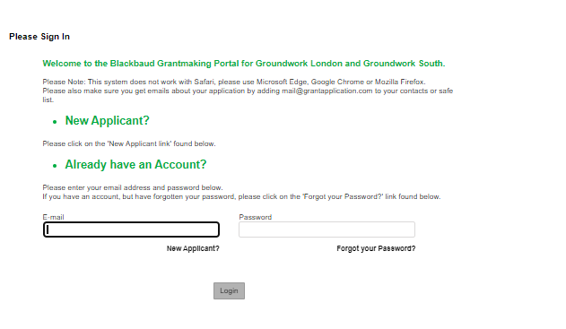

Creating an account on BBGM
Email address
Memorable password
Make note of your login details – for application and reporting purposes (if successful)
Notes:
In order to access the application form, save and review your progress, you need to create an account to the BBGM Platform.
Click on the relevant application link in the previous slide, you will be transferred to the BBGM platform. You will be asked to log in or register as a new applicant.
If you already have an account you will be able to find your application in the "In progress" applications upon you log in.

Slide 17
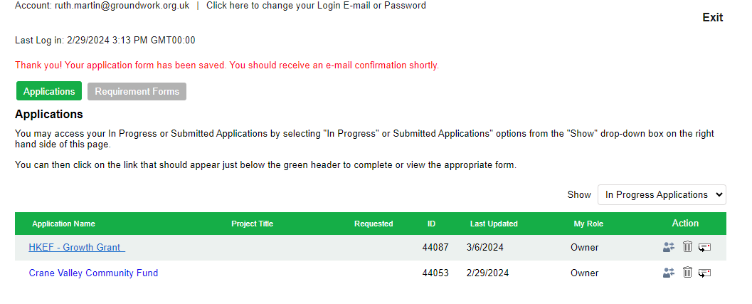
logging in into BBGM
Please click here to access BBGM login page.
Enter your registered email address and password to login.
You will see all your drafted applications – ensure you selected ‘In Progress Applications’ in drop-down menu.

Slide 18

Problems logging in
Forgot your registered email address?
Forgot your password?
Having problems logging in?
Can’t find your draft applications?
Problems using BBGM?
Please email and get in touch with us at HKEmpowermentFund@groundwork.org.uk

Slide 19
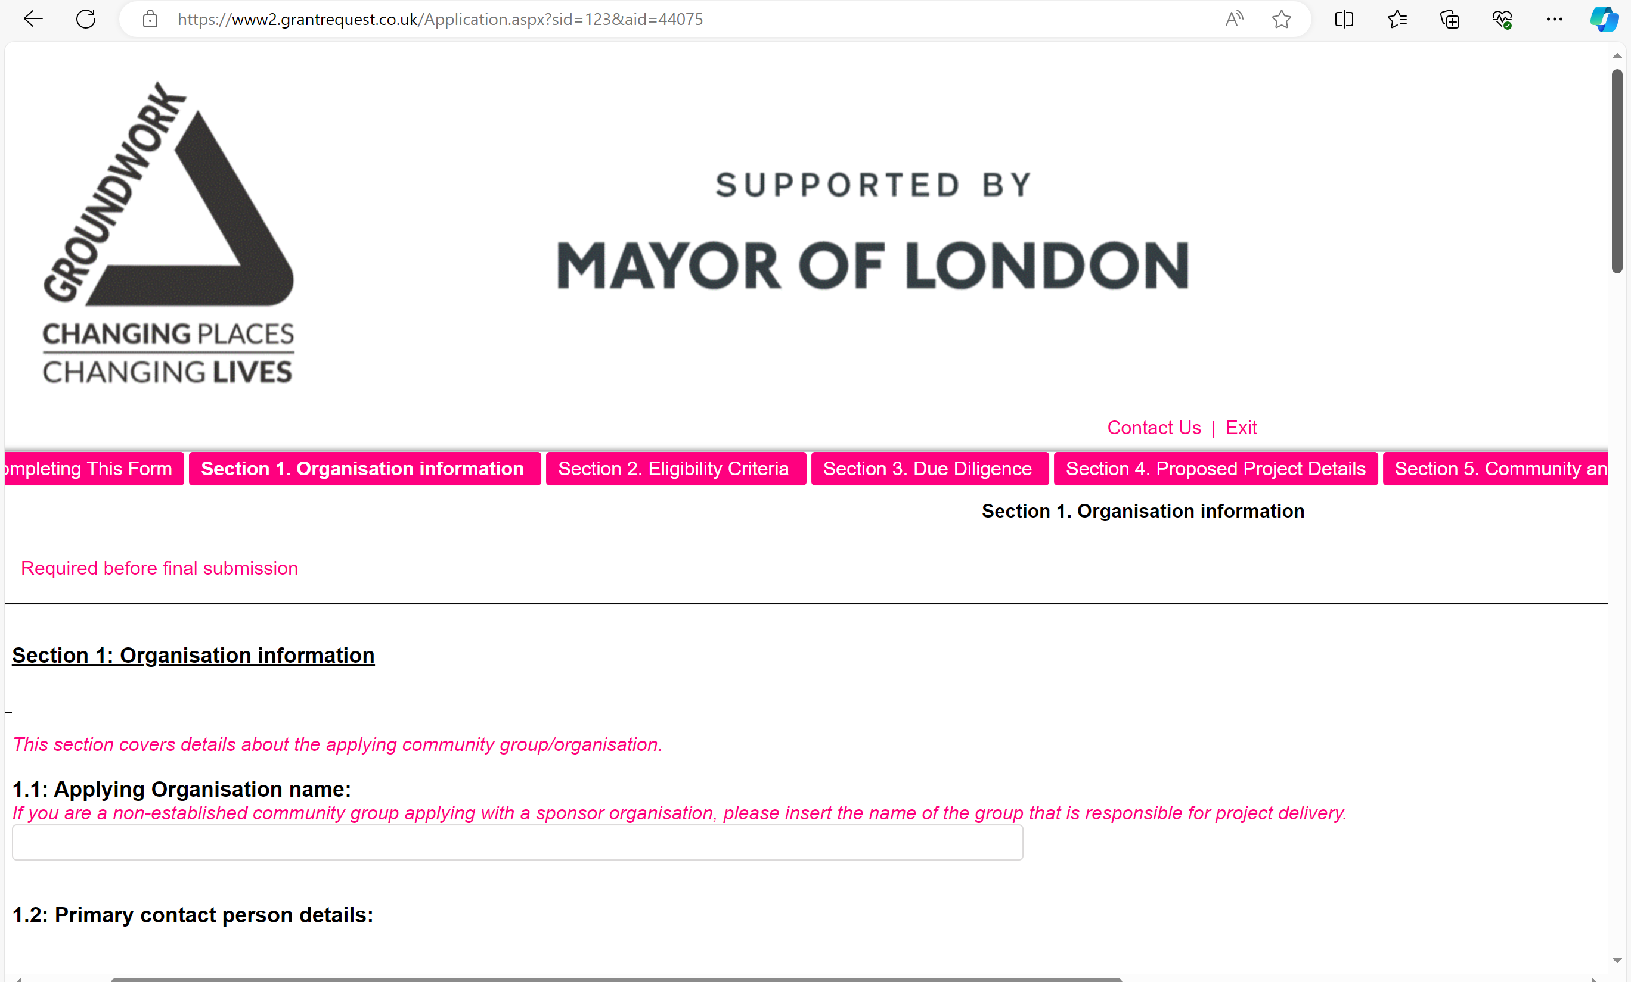
Section 1 – Organisation information
Growth grant
  Applying organisation = project delivery organisation
  Sponsor organisation – only applicable to applicants who are not a legally constituted group
Collaboration grant
  Lead organisation = lead partner
  Partnering – please list all
Social media – please list all social media handles for applying and sponsor organisations in Growth; lead and partnering orgs for Collaboration
Borough – select all relevant boroughs based on your project delivery location(s). For online activities = Whole of London.
Notes:
Section 1 – Organisation information
- For Growth Grant applicants, applying organisation is the group/organisation that is responsible for project delivery. Sponsor organisation details is only applicable to non-legally constituted applying organisaton
- For Collaboration Grant applicants, lead organisation details is for the lead partner. You must include all partnering organisation details in your application form.
- Social media: please include all social media handles for Applying Organisation and Sponsor Organisation (Growth Grant applicants) and Lead Organisation and Partnering Organisation(s) (Collaboration Grant applicants).
- Boroughs: please include the borough/s in which your organisation is running the project activities. You can tick more than one option if you are active in many boroughs, and if you intend to run projects online, you can choose 'Whole of London'.

Slide 20
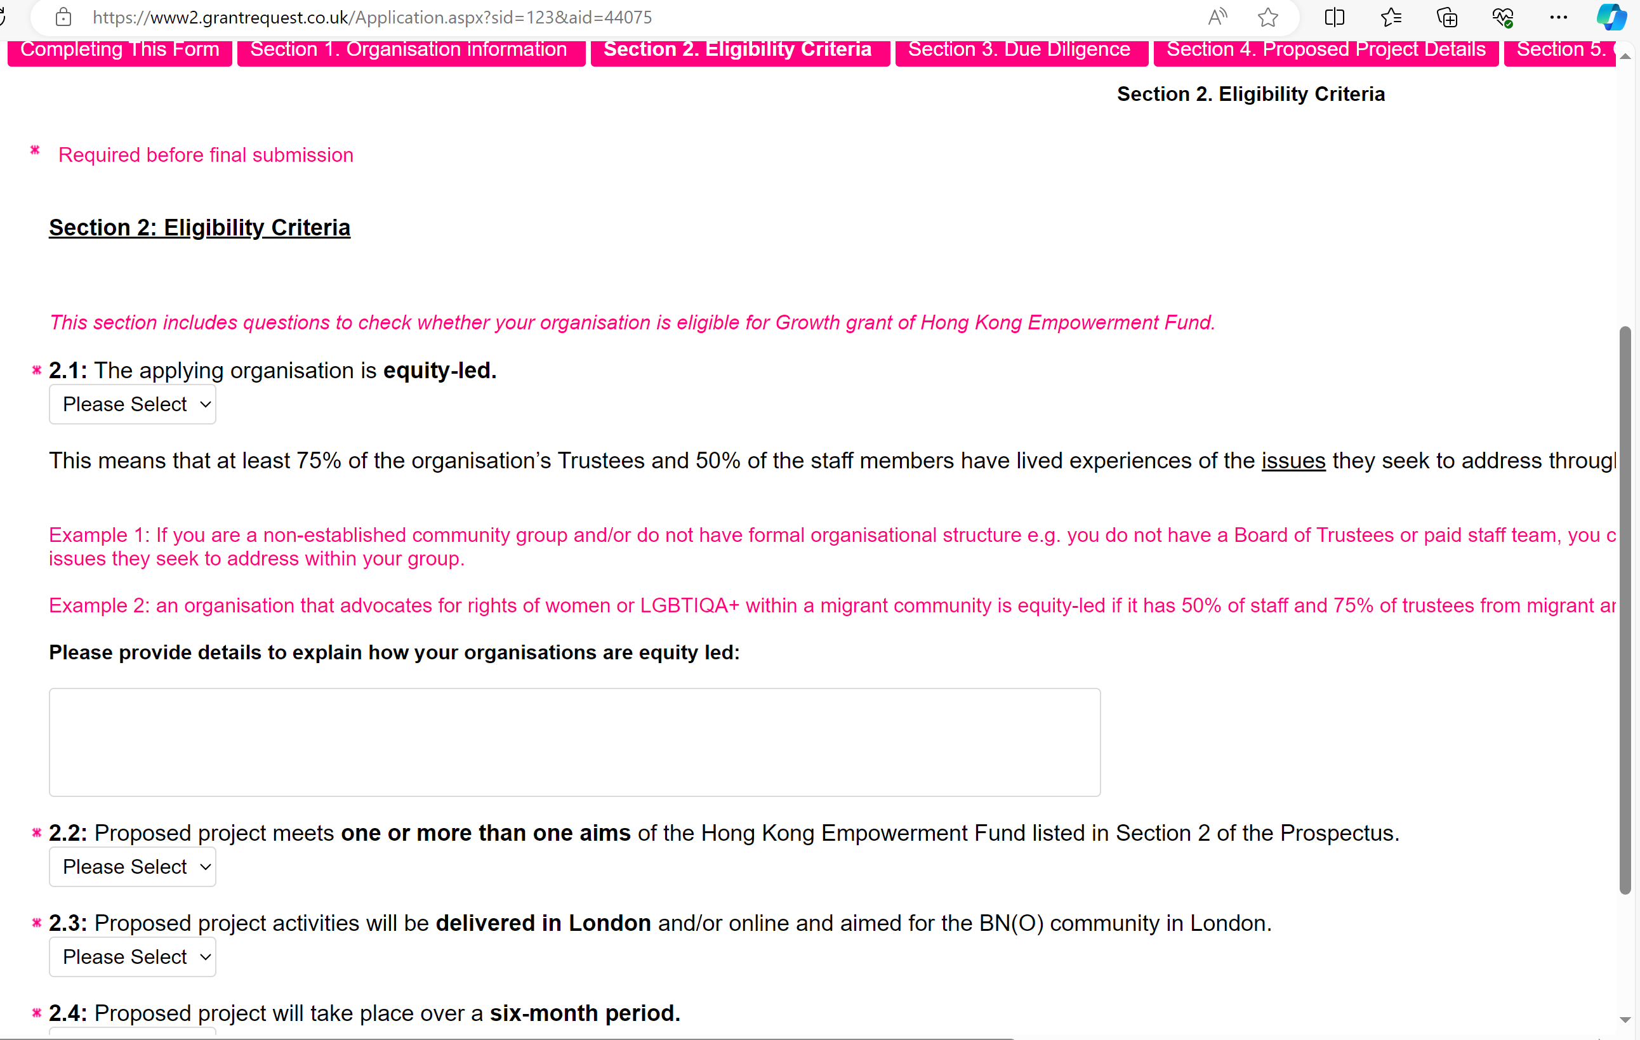
Section 2 – eligibility criteria
2.1 Equity-led question
  Yes/No
  Provide brief information to support your answer.
Notes:
Please use the drop-down list to answer with 'Yes' or 'No' to all eligibility criteria.
For the Equity-led question, you need to explain how your organisation or group is equity-led. Please use the free text box to explain. You don't need to be a constituted organisation to be equity-led.
This means that at least 75% of the organisation’s Trustees and 50% of the staff members have lived experiences of the issues they seek to address through their proposed projects.
Example 1: If you are a non-established community group and/or do not have formal organisational structure e.g. you do not have a Board of Trustees or paid staff team, you can still be an equity-led if a majority of your group members have lived experience of the issues they seek to address within your group.
Example 2: an organisation that advocates for rights of women or LGBTIQA+ within a migrant community is equity-led if it has 50% of staff and 75% of trustees from migrant and/or migrant LGBTIQA+ or migrant women backgrounds.

Slide 21
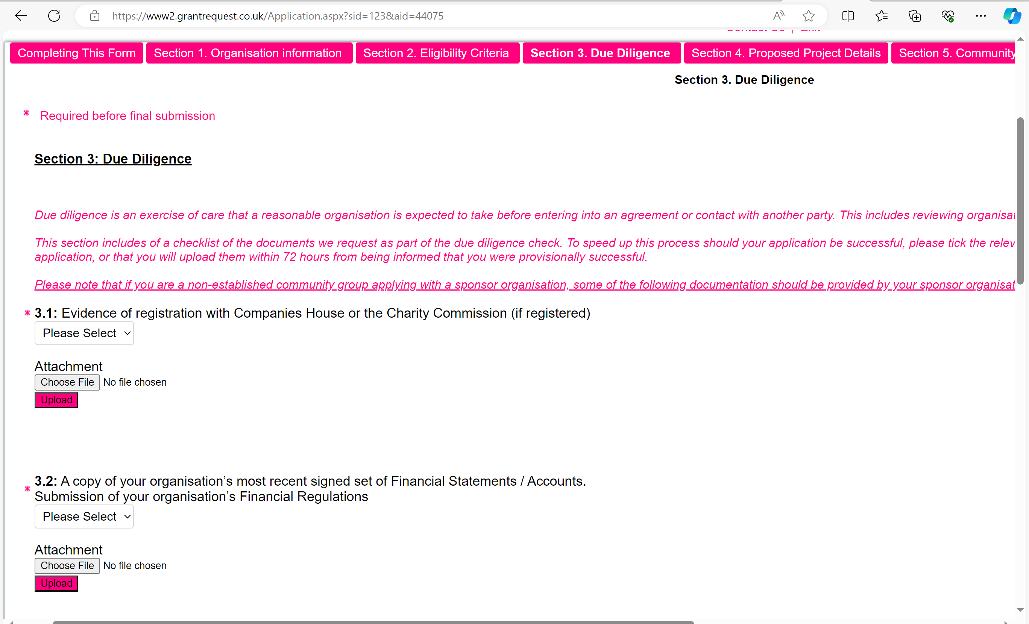
Section 3 – due diligence
Where possible, upload all documentations during application stage.
Growth grant
  Some documents will be provided by your sponsor organisation
Collaboration grant
  Documents should be provided by the lead organisation
If you do not have documentations available for uploading at the application stage, please provide explanation in the textbox on how you intend to have these in place prior to activities commencing.
Notes:
All applicants are also required to submit some organisational documentation preferably at the written application stage. If applicants are unable to provide any of the following documents, they may provide a written statement demonstrating how they intend to have these in place prior to the activities commencing. Their planned approach will be clarified at interview if shortlisted, and the deliverability of this will form part of the decision-making process. Project activities will not be permitted to begin until all these policies are in place.
The documents are:
Safeguarding Policy
Equality and Diversity Policy
Two letters of recommendation from a trusted authority (e.g. a church, minister/pastor, GP, charity etc) or anyone in a civic position to vouch for your group. The letter should outline why they believe your group is a good fit for our grant.
Confirmation of the organisation’s annual turnover in the last financial year.
Confirmation that the applying organisation/sponsor organisation has a bank account requiring two signatories.

Slide 22
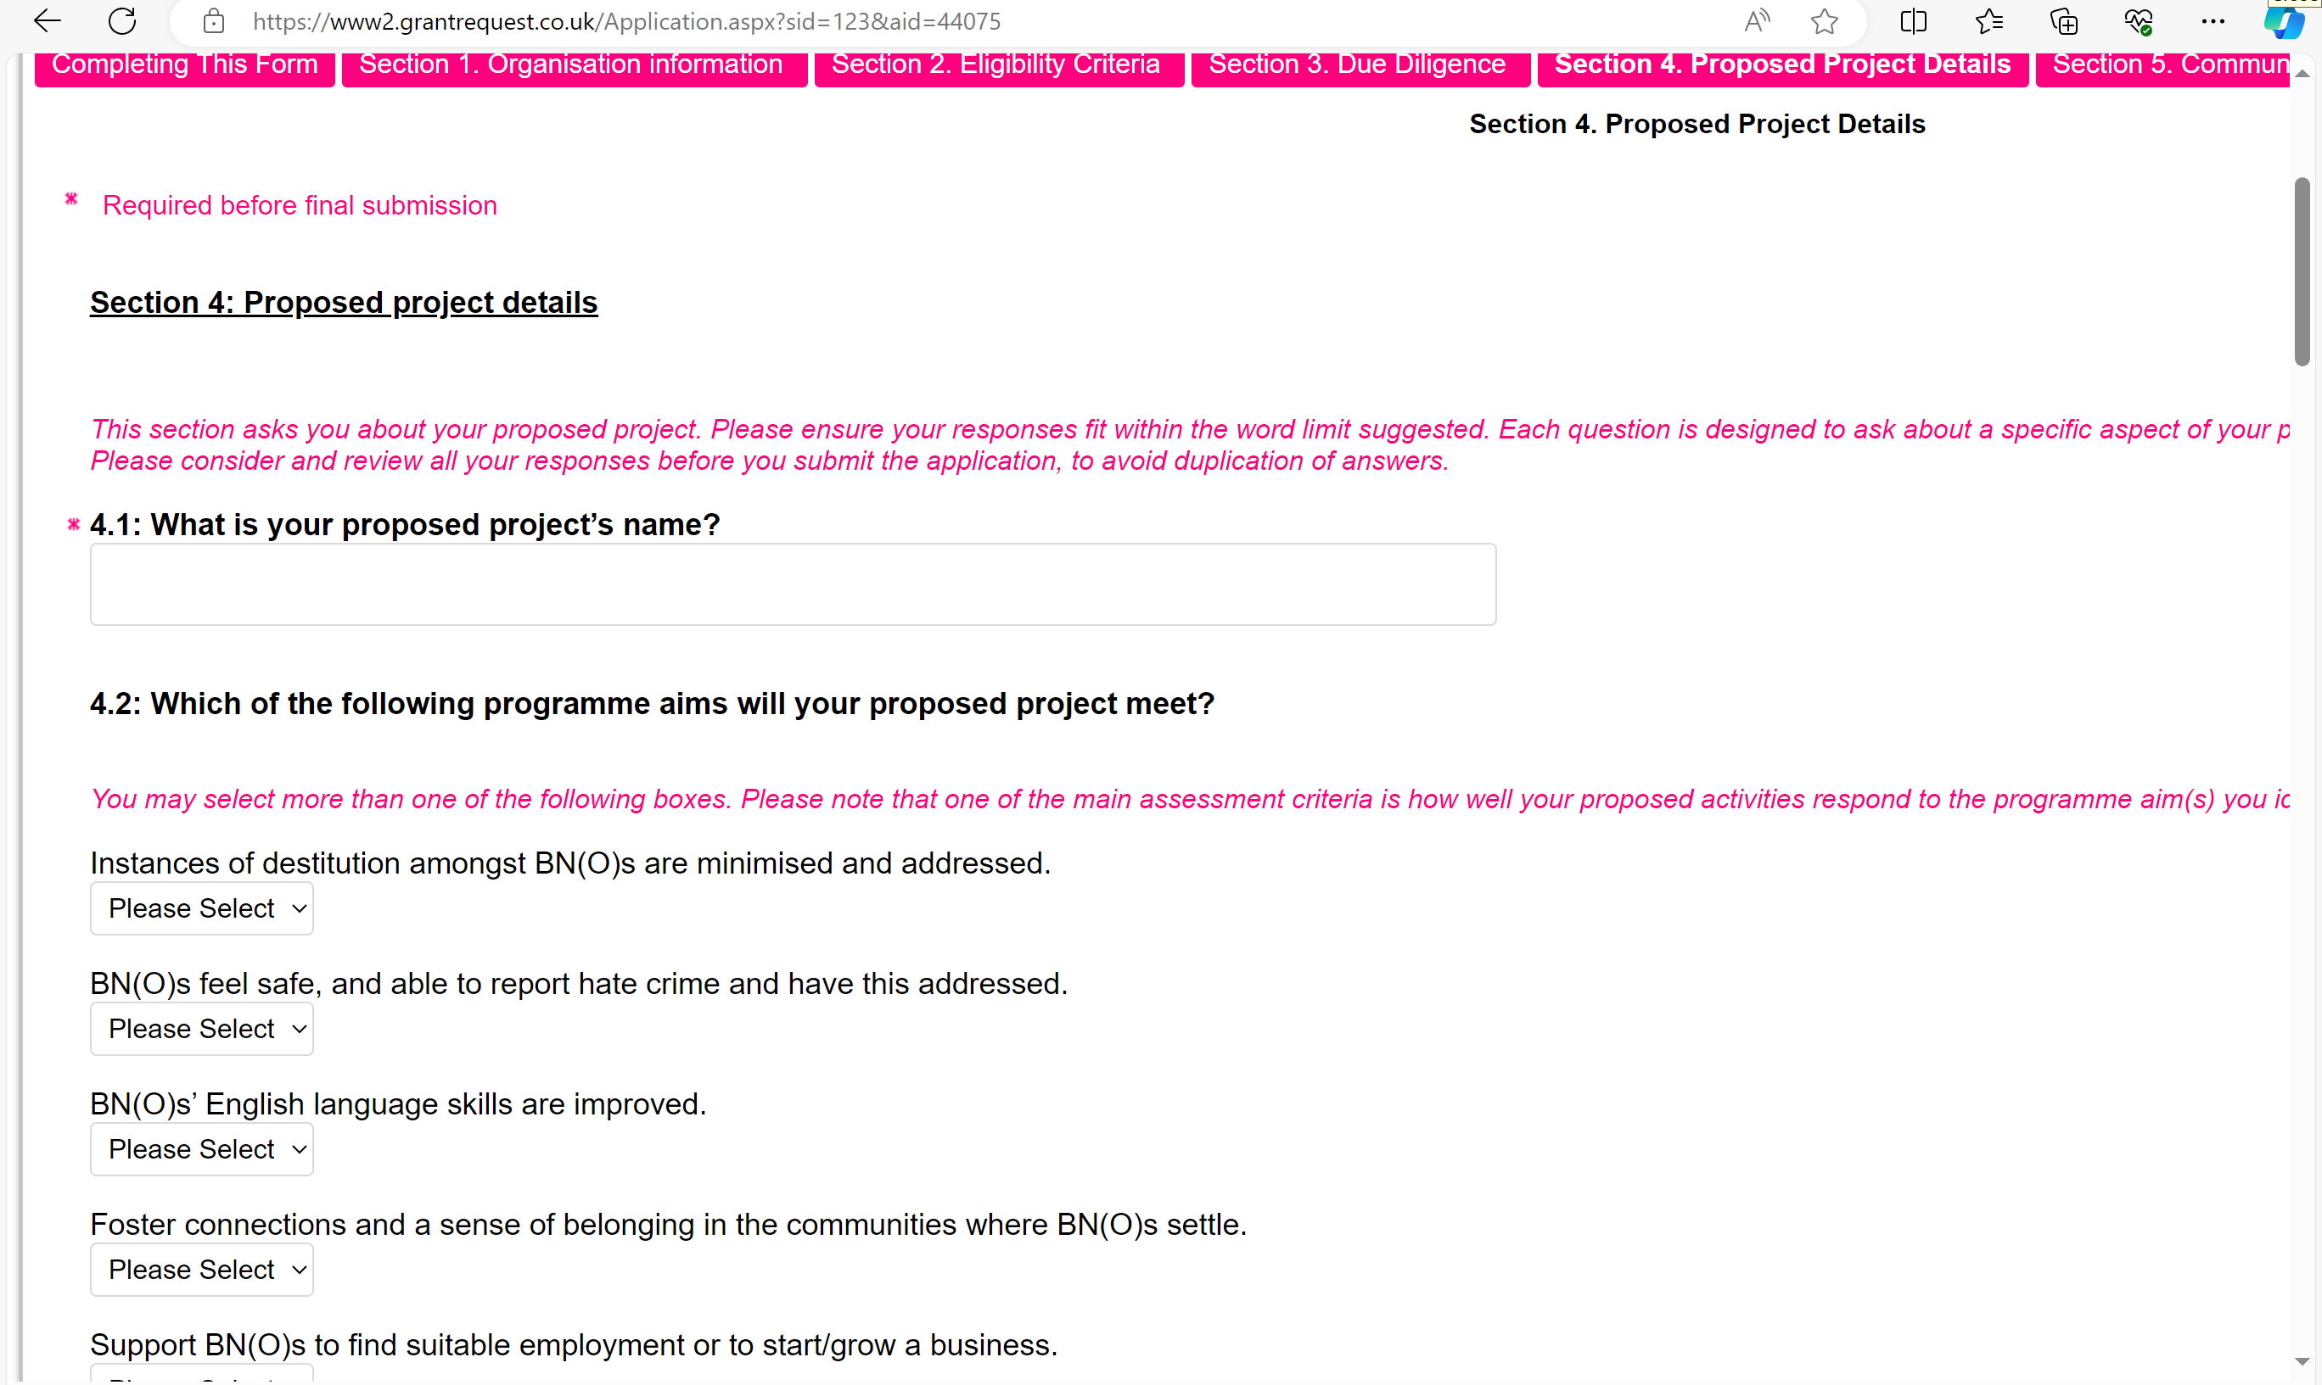
Section 4 - Proposed project details
Q4.2 – Programme aims
Q4.3 – Needs you identified in the BN(O) community
Q4.5 – You should answer this question if English language support is part of your proposed project plan.
  Adult Education Budget and DLUHC’s £850 demand-led English language support
  To avoid duplication of funding
  Refer to Annex 2 of the Programme Prospectus for more information
Q4.7 – Monitoring & Evaluation
Q4.8 – Project plan and Q4.9 – Project budget
4-sentence summary about your project.
Notes:
Q4.2 Programme aims: one of the main assessment criteria is how well your proposed activities respond to the programme aim(s) you identified below, rather than the number of aim(s) selected.
Q4.3 BN(O) community needs: what is the need that you have identified in the community, and how does your project respond to the need? Example: through a survey that you sent to participants of a previous project of yours, respondents highlighted a need for mental health support. Your proposed project will for example organise group therapy sessions, or mental health awareness raising sessions, or provide counselling, etc. Or you have identified that there is a need for mental health support because you engaged with some BN(O)s in your past projects.
Q4.5 English language learning: If your proposed project includes an element of English Language provision, you should answer question 4.5. You are asked to explain why your proposed English learning element cannot be covered by Adult Education Budget (AEB) and DLUHC’s £850 demand-led English language support. We included more information about these two funding options in Annex 2 of the Programme Prospectus. We ask for this information because we would like to avoid duplication of funding and would encourage organisations to utilise all funding options available as much as possible.
Q4.7 Monitoring and evaluation: The GLA is interested in learning about the positive impact that groups and VCSEs we fund make on BN(O)s lives and on the organisations themselves. We ask funded groups and organisations to monitor the impact of their work according to the specific aim(s) they intend to address through their project. Please include indicators of your project's success and methods of how you intend to measure the impact. Please refer to the list of indicators in the prospectus. This list is not exhaustive and you can always come up with your own indicators.
Example: your organisation has qualified counsellors and your project focuses on connecting BNOs to mainstream mental health services and providing interim mental health support. The aim to connect BNOs to mainstream services and improve their mental health. Some possible indicators to measure the progress your project made to achieving these aims are service users self-reporting their mental health has improved, and numbers of referrals made and accepted to mental health services.
Reporting impact can take other shapes like case studies, testimonials, quotes, etc depending on the nature of your project. Example: You provide mental health support to participants of your project. A success indicator could be # of BN(O)s who reported that their mental health has improved as a result of attending your sessions or your services. Or # of BN(O)s who reported feeling less isolated or # of BN(O)s who kept coming back to your sessions.
Q4.8 Project Plan: In addition to listing out all your main events and activities, please consider also including key steps to your project delivery, e.g. preparation, recruitment, monitoring and evaluation etc, and include as much description about each activity as possible. Please use the template provided (download, fill-in, then upload). Please remember to include monitoring evaluation tools and resources in you plan (staff or volunteers time, server to save responses to surveys, etc).
Q4.9 Project Budget: Excel template – You can either list the cost items as General project cost or by event/activity. Both templates should be uploaded in Word and Excel because if successful these documents will be included in grant agreement and will be referred to through your project delivery period.
Q4.10 Project summary: We ask this question as for many projects, it is important that organisations to present their project activities and aims in a concise and succinct manner, as this may be asked by your prospective participants, funders and other organisations working with Hongkongers. Hence, please use this question to think how you can highlight the background of your group and the key points of your proposed project.

Slide 23
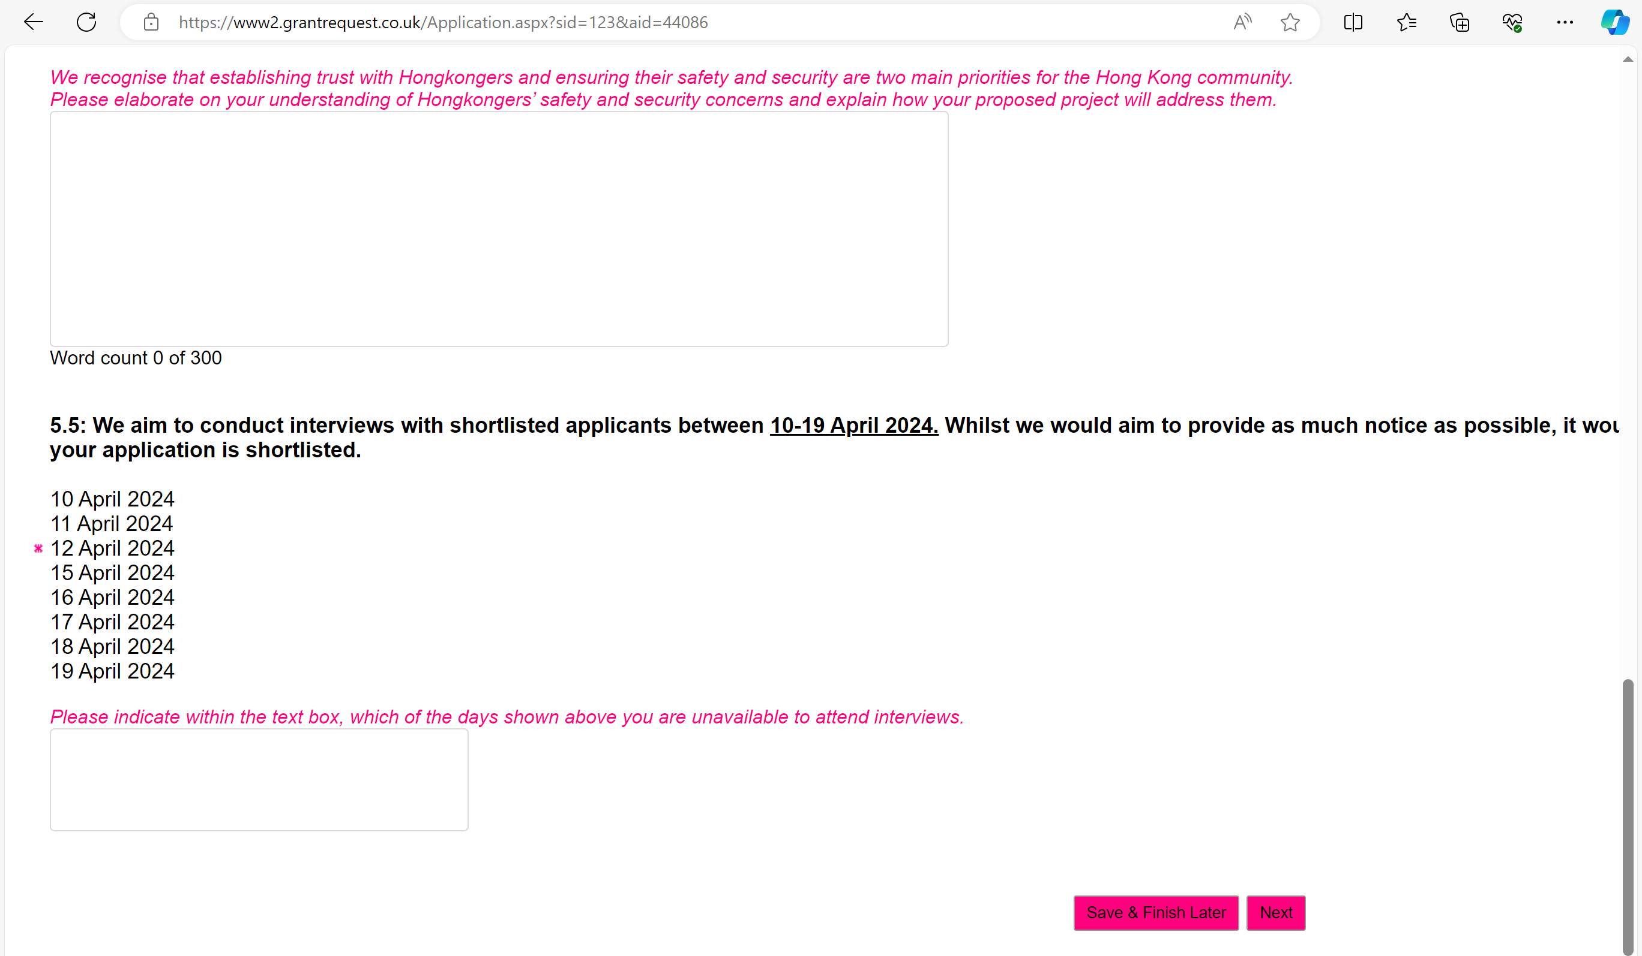
Section 5 - Community & Target Audience
Q5.2 – Target direct and indirect participants
  To be realistic with the targets
Q5.5 – Interview availability
Notes:
Q5.2 Target number of direct and indirect participants: number of participants is an often-used indicator when it comes to project delivery, but we recognise this only tells us a partial story of the impact of work delivered. We value both quantitative and qualitative information. Please be realistic with your target numbers provided , as one of the main assessment criteria of your application is how realistic it is to meet the identified objectives and target.
Direct participants are people who will directly access your services or attend your activities.
Indirect participants are people who will benefit as a result of your project, despite not directly engaging with it. This may include other family members or people from the wider community.
Q5.5 Interview availability After the first stage of application, we will shortlist applications. We will then invite shortlisted applicants for interview. We expect interviews to be held between 10th to 19th April 2024. Please indicate in Question 5.5 which of those dates you will not be available, so we can take this into account when we offer interview slots. We will try to provide you with as much notice as possible but please note that the turnaround time of this may be short. We will provide more details of what you may expect in the interview in due course.

Slide 24
General tips
Ensure you meet ALL eligibility criteria before you start an application
Plan in advance - deadline is 27 March 2024 at 9am
Answer ALL questions
Read help text for each question (pink italics)
If you have any questions, please contact us ideally before 18/3/24
Notes:
General tips
- Make sure your organisation and project meet all eligibility criteria before you start the application – we don’t want you to waste your time
- Plan in advance – deadline for the application window is Wednesday 27th March 2024 at 9am. Please try not to leave submission to the last minute, to avoid overloading the online system and causing further delays.
- Answer all questions, unless they don’t apply to you e.g. sponsor organisation question or English language support
- When you go through the application on BBGM, please read the help text in pink italics in each question. We designed each question with a specific purpose in mind, and the help text is there to help you identify what information to include in your response. Please consider reading all the questions first and planning your responses, so as to avoid duplication in your answers.
- As mentioned previously, the pre-election period starts on 19/3/24. That means from that day onwards, the ability for Groundwork London and GLA to answer questions directly will be limited. There will still be technical support on and after 19/3/24, so if you have any technical issues submitting the form and accessing BBGM platform, please contact us. We highly encourage you to get in touch with us before 18/3/24 if you have non-technical questions about the funding programme.

Slide 25
HK Empowerment Fund timeline
Activity | Date
Application Deadline | Wednesday, 27th March 2024 at 9am
Interviews | Wednesday 10th – Friday 19th April 2024
Inception meeting with successful applicants | May 2024
Project delivery | End of May 2024 to November 2024
End-of-project report submission | December 2024
Notes:
- Application close on Wednesday 27th March 2024 at 9am.
- Shortlisted applicants will be invited to interviews during 10th-19th April 2024. During the interview, applicants will have the opportunity to talk us through their organisation and project idea through a short 2-3 minute presentation. The panel will ask clarifying questions based on the responses you submitted at your written application and there will be a chance for you to ask us questions.
- Inception meeting with successful applicants will happen in May 2024.
- All project activities must be delivered and completed in November 2024.
- End of project report should be submitted in December 2024.

Slide 26


Key contacts and resources
Key email contacts
Groundwork London: HKEmpowermentFund@groundwork.org.uk
Greater London Authority: HongKongVCSE@london.gov.uk
Please send your queries to both email addresses
Supporting documents available
Hong Kong Empowerment Fund Programme Prospectus
Frequently Asked Questions – to be added
Info session recording – to be added and shared after this session
Info session slides - to be added and shared after this session
All supporting documents will be uploaded and updated on Groundwork London’s website.

Slide 27
QUESTIONS?
Recording will stop now.
Any frequently asked questions and answers will be posted on Groundwork's Hong Kong Empowerment Fund website.

