Slide 1


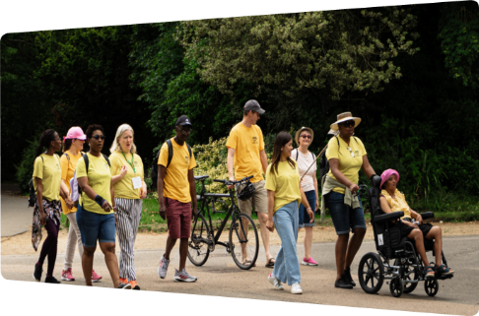

GHCF Evaluation – Wave 2
Phases 1&2: Progress Report and key findings
July 2026

Slide 2


Table of contents
Key findings and learning
Overview to Wave 2 approach and participation
Reach of GHCF
Analysis highlights
Recommendations and next steps
                Wave 2 key findings
                Learning from and for grantees
                Experience with the fund
                VCSE outcomes and impacts
                Beneficiary outcomes and impacts
                The health system in Greenwich

Slide 3

Document guidance
You may wish to view sections that interest you in turn, rather than read this document page by page – please see the contents page above to guide you.
Anonymised quotes from participants are included, and formatted as such “xxxx” and the strand and data source they reflect are referred to throughout the presentation.
Throughout we often refer simply to ‘VCSEs’ to refer to fund grantees overall, which may reflect different types of individuals, groups, and more formal organisations.
Some Case Studies are referred to, which are available to view on the dedicated webpage.
All pictures used in this presentation have creative use license and graphs and visuals are created by DG Cities.
Access our webpage here:
https://www.dgcities.com/ghc

Slide 4
Purpose of the GHCF evaluation
DG Cities was commissioned in 2025 to:
Assess the impact of the GHCF on organisations and communities.
Provide knowledge exchange and capacity building to participating organisations in the fund.
Provide GHCF’s key stakeholders with evidence, insights and stories to showcase impacts and learning from the VCSE sector in the borough.
The Greenwich Healthier Communities Fund aims to prevent and respond to health inequalities across the Royal Borough of Greenwich to ensure everyone has equal access to the services and support they need.
GHCF consults, co-designs, and provides funding (running 2024-2028) to organisations and communities across Greenwich.

Slide 5
1. Key findings and learnings – Wave 2
The next two slides summarise the key findings that have emerged from Wave 2 of the evaluation.
These are then followed by three slides covering some of the learning from GHCF grantees in Wave 2, which may be useful for others.

Slide 6

Key findings 1-4
As an overview, these key findings emerged in wave 2.
1
3
Has funded a notable number and diversity of projects. The location of grant delivery is quite well aligned to the six priority wards identified in the NHS Grant-giving strategy.
The networking – can be a particularly valuable element for grantees including to gain information, know local signposting, learn about local opportunities and to be encouraged to make connections and start collaboration. However, the networking may need ongoing adaptations to realise these opportunities.
2
4
Grantees have positively reported on the health inequalities focus of GHCF being of real interest and a passion for them, and in it being a generally supportive fund that has some better elements than other grants they apply for.
Overall, there is good emerging evidence that VCSEs are becoming better able to address local health inequalities - in pilots, projects and for future work.

Slide 7

Key findings 5-8
As an overview, these key findings emerged in wave 2.
5
7
Parts of the GHCF Theory of Change is well aligned to the actual outcomes and impacts of grantee projects – such as improving social connection and subjective wellbeing for communities; providing access to resources for healthy behaviour; and being able to support one’s own mental health better.
Collaborative practices are becoming increasingly popular - multiple VCSEs are aiming to increase their awareness of the support available in the borough in order to identify which gaps/where they can fit it and also become well-known themselves. Grantees identify systems working as a pathway to reaching more people, supporting them for better/longer, and ultimately increasing their readiness for future funding and the sustainability of their organisation.
6
Grantees who had a longer delivery timeline, typically on the Delivery strand, were more likely to benefit from a more consistent participant base. There are excellent examples of how reaching and bringing people into safe and trusted community-settings and building connection can be a catalyst for further change.
8
Other parts of the Theory of Change, such as building a more resilient VCSE sector and reducing the need for statutory services, are less well-evidenced and will continue to be explored.

Slide 8
Good practices and examples from grantees
To have a range of staff and volunteers who reflect and represent the community’s own diversity.
1
Developing a sense of ownership and agency for beneficiaries, for how much they engage and what they can then take away from the activity.
2
The value of ongoing light-touch communications and updates with beneficiaries, potential collaborators, and local providers.
3
Exploring where there are skills available from the community to volunteer.
Introducing people to opportunities to support or even join your team, at the right pace.
4
Adaptability! – understanding what (potential) beneficiaries really need and want. Sometimes this is just small adjustments to timings, the materials that are shared, or even the way that food is included.
5
Using digital systems and structured ways of registering participation, to keep track and keep in touch with participants safely.
6
Wave 2 additions >>
Proportional, appropriate evaluation methods for participants to feedback and share learning. This could be built into your sessions to be reflective and useful for participants; they could be informal or even fun parts of your sessions. (see next slides)
7
Marketing and communication – to prepare for and improve this by: looking to bring in dedicated resources, to collaborate with others, or using established channels in Greenwich
8

Slide 9
Learning from grantees – collaborate and connect effectively
The following summarises some good practices and tips from grantees for how they have been able to collaborate and connect in Greenwich – together and to others.
Bringing together different activities can be useful
Some grantees have successfully developed a ‘more holistic approach’ that supports both physical and mental health.
Ongoing communication and check-in points with partners
This has helped grantees collaborate well with local organisations, whilst being open to each adapt to feedback and requirements.
Time and care to create safe spaces and belonging for participants
Understanding the needs of those who are less engaged elsewhere, to provide an accessible option that feels safe and appealing.
Time and care to create safe spaces and belonging for participants (continued)
Giving participants ownership on scheduling, shaping and communicating about next sessions.
Being open to network and learn
With relevant networks and events to meet others supporting local communities and offering something similar/ complementing to your offer.
Asking about local services & support– and how to connect with them.
More learning is shared later in this presentation – in Section 4, including overcoming challenges and emerging changes in the Greenwich health system.

Slide 10
Learning from grantees – appropriate evaluation
Good practices and tips from grantees for how they evaluated their work or received useful feedback from their beneficiaries to adapt what they do:
Using best practice measures of subjective wellbeing and health reporting.
Capturing the baseline of beneficiaries.
Repeating measures at in- and post-delivery points.
Capturing beneficiaries’ knowledge changes, awareness and use of available support and resources.
Capturing beneficiary stories and journeys – in how they navigate health inequalities or undertake opportunities.
Using WhatsApp groups to capture feedback and run short polls.
Building in learning and feedback moments into usual sessions.
Conversational and self-reflective approaches are also useful tools for beneficiaries to share their experience and story, to reflect what they have learnt and what has changed for them.
These can often be wrapped up into the project’s sessions/ activities in enjoyable ways, such as to write own stories or create group posters.
We learnt…
I enjoyed…
I now do this…

Slide 11
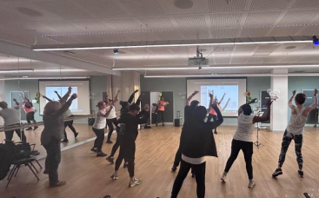
Learning from grantees – Published Case Studies
https://www.dgcities.com/ghc
A set of Case Studies have been developed, from randomly selected participants. These are available on the dedicated webpage and set out useful learning for others.
Wave 1 Case Studies:
#1 Raise the Roof: Building a community through fitness
#2 Supporting SEND: Better assistance to parents, carers, and professionals
#3 Keep on Moving: Creative exercises with safety and connection
#4 REACH: Creative Health - advocacy and collaboration
Wave 2 Case Studies:
#1 Afghan Women’s Empowerment: Building a community
#2 Little Me Being Free: Children’s emotional literacy
#3 Men’s mental health drop-in club
#4 BlindAid: Connecting and helping visually impaired adults
#5 Abkara Women’s Group: Addressing health barriers
#6 Multi-sports for people with disabilities
Each Case Study covers:
-What was delivered
-Who was involved
-The changes and impacts
- Overcoming challenges
- Lessons learned
- Next steps

Slide 12
2. Approach to the evaluation – Wave 2
These next three slides set out:
Who took part in this evaluation wave 2
The methods used to gather insights and data from grantees
Reflections on the approach, with what worked well and what could be refined in future waves.

Slide 13
Wave 2 - Progress Evaluation Report
Engagement phase: February 2026 – April 2026
This wave of the evaluation, covers grantees who:
a) Were funded in Phase 1 of the fund but were not ready for Evaluation Wave 1:
Phase 1 Delivery: 31, of these 20 had data input for the evaluation
Phase 1 Enabling: 17, of these just 8 had data input
b) Were funded in Phase 2 and had delivered most of their project up to and including March 2026:
Phase 2 Enabling: 9, of these all 9 had data input
Phase 2 Micro: 12, of these 10 had data input.
The Wave 2 analysis validates trends identified in the last wave, looks for new and different approaches, and notes longer-term changes. This analysis includes representatives of the new Micro strand and continues to focus on understanding GHCF’s impact on addressing health inequalities within Greenwich’s communities. The progress evaluation report provides an updated, evidence-based learnings about VCSE and beneficiary impacts and the fund’s role in achieving those, and offers recommendations for GHCF and the funders, for GHCF grantees, and for the Greenwich system.

Slide 14
Our Methodology – Overview
Primary & secondary data to the evaluation
30 Questionnaire responses
Nine interviews
37 Monitoring forms
Eight case studies
Five 1:1 conversations
Using recommendations from Wave 1, the following adjustments were made to the methods in Wave 2:
Guidance for grantees on how to respond to questions about who the beneficiaries are and judging the extent of impacts.
A focus in the communication that the independent evaluation has no bearing on future applications - so grantees can be transparent and honest.
Phone calls were offered as an alternative to the online questionnaire form.
Calls were also made to those who had not participated in the questionnaire, with the option to share their experience and feedback through these conversations instead.

Slide 15
Waves 1&2 engagement reflections
What worked well… Interviews were very positive – grantees provided important insights and shared openly. Questionnaire design was flexible, allowing both quick responses (reducing burden) and detailed input (with optional questions). Tailored questionnaire for each strand with options to complete it online or via telephone. We will continue to offer this in future waves. Attending networking meetings to meet the grantees in person, and present the evaluation. Making clear our independent role and focus on helping to share lessons and improving the fund. Asking grantees if they wanted certain feedback and asks to be attributed to them and raised directly with the funder.
And considerations for future waves… Continue to review and refine the methods to ensure they are accessible across different VCSE types and proportional to grant sizes. Continue to consider easier ways to gather “negative” perspectives or about VCSE challenges e.g. short email polls or clear open questions to encourage explanation. Some grantees were not clear on the difference between the Monitoring Form and the independent evaluation. It is also important to ensure that both are of proportionate size to projects’ grants. We will also revisit the GHCF Theory of Change to ensure its continued alignment.

Slide 16
3. Reach of GHCF -
For Phase 2 (so far)
These next five slides summarise:
What has been funded
Where funding has been delivered
What have been the inputs of these funded grants
What have been the outputs of these funded grants

Slide 17
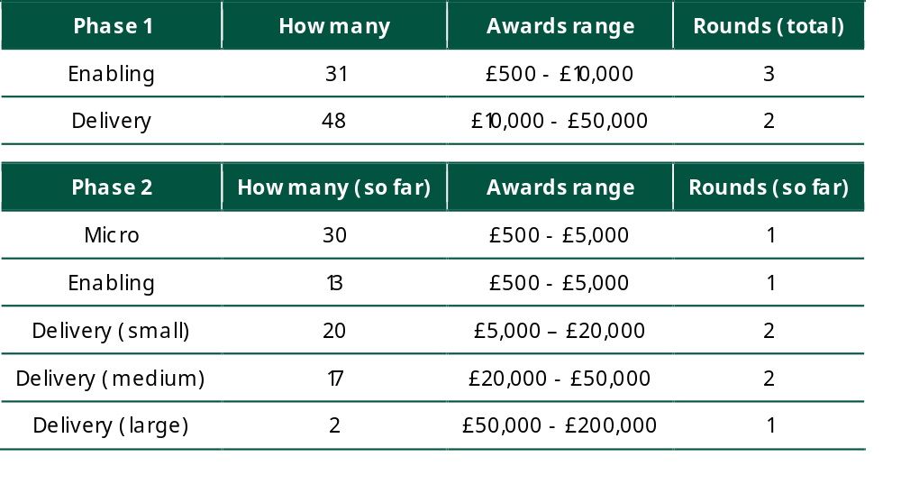


What’s been funded
The GHCF grants fit under diverse themes, categories, and priority areas, with some overlaps.
Higher proportions of awarded grants covered the following themes: NHS themes: Health behaviours – 22 Delivery, 5 Enabling, and 20 Micro (Phase 2 to date) Socio-economic – 12 Delivery, 2 Enabling, and 8 Micro (Phase 2 to date) RBG H&W strategy 5 Wells: All ‘Wells’ were very well represented. ‘Age Well’ has the least number of awarded projects so far and none in the Enabling strand. NHS Greenwich Charitable Funds Grant Making Strategy – most relevant areas have been mental health, children and young people, and physical exercise. Re-applications: Multiple VCSEs had previous RBG or GHCF funding. This was usually beneficial to their current funded project but more evidence is needed.
Includes projects that are focused on the VCSEs capacity and a new ‘Micro’ strand was introduced
Funds the continuation or introduction of small pilot projects to enable the testing of new or adapted approaches to prevent or address health inequalities.

Slide 18
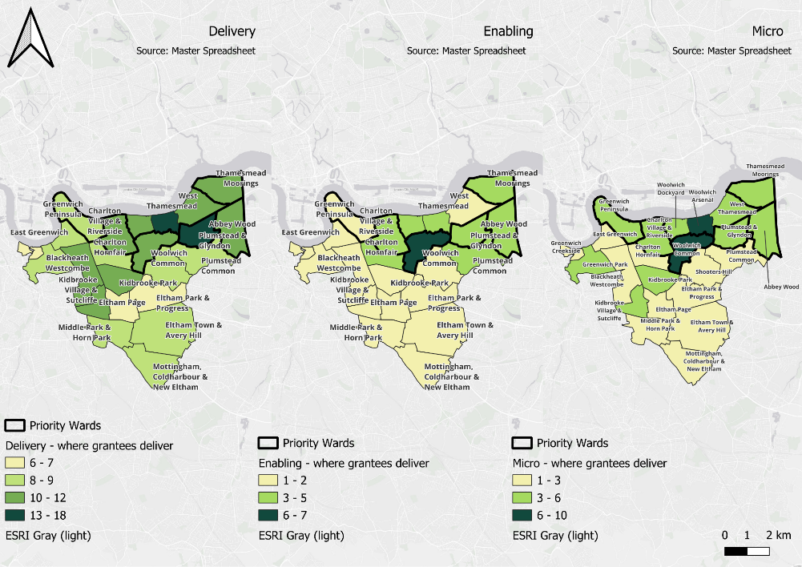
Priority wards (bolded) – Abbey Wood, Plumstead and Glyndon, Greenwich Peninsula, Thameside Moorings, Woolwich Common, and Charlton Village &Woolwich Riverside.
Delivery -
Enabling -
Micro -
Woolwich Arsenal and Plumstead & Glyndon continue to be areas where more grantees support local communities in preventing or reducing health inequalities.
Woolwich Common is beginning to emerge as another cluster area for Phase 2 projects.

Slide 19
Inputs
Enabling
Improve internal capacity, including:
  Purchasing equipment and/or resources needed for delivery;
  Recruiting and training staff and/or volunteers;
  Improving facilities and/or services offered.
Some Phase 1 Enabling grantees also had funding for small or pilot projects.
Delivery
A wider set of inputs have been funded, reflected from the wider categories in the GHCF prospectus:
  Revenue spending (including staff costs);
  Venue hires & equipment;
  Project-specific training (directly related to the project but not the main focus).
Micro
Funding to run small and pilot activities, including
  Staff costs;
  Venue hire;
  Small resource additions (e.g. leaflets, website, design, equipment).

Slide 20

Outputs
Enabling
Improve internal capacity, including:
Equipment and new resources for delivery;
New staff or volunteers;
Training for staff/ volunteers; and
Improved facilities.
Some Phase 1 Enabling grantees also had funding for small or pilot projects, including:
Improvements to a local park for children’s play and sports.
A community pantry for better access to healthy food, and SEND tailored café provision.
Micro
Examples of outputs from the fund include:
Community-led spaces for health & economic opportunities support within marginalised communities
Food, connection and physical activity practice.
Movement and mindfulness activities.
Art-based space for health conversations and information.
Creative activities and safe spaces for marginalised communities.
Tailored movement and wellbeing support for primary school children.
Dance classes for creative expression and better access.

Slide 21
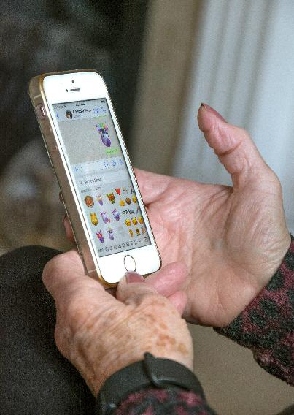
Outputs
Delivery
Examples of outputs from the fund include:
Culturally-relevant classes and physical activities to extend community connection.
Bespoke training and support for volunteers.
Drama and art therapy sessions with accompanying support for young people.
Half-term activities and food for low-income households.
Targeted digital inclusion support.
Free, culturally sensitive, and trauma-informed emotional support for marginalised communities.
SEND Families: Safe spaces, activity participation, skills building, and family connection.
Safe and accessible physical sports participation for people with disabilities.
Refugee & vulnerable people support: Connection, health support, service navigation, and skills support.

Slide 22

4.1 Analysis –
Grantee experience and feedback -
The next ten slides provide:
How grantees rated their fund experience
Key challenges that grantees faced, and how they were overcome
Benefits and experience with networking, collaboration and partners

Slide 23
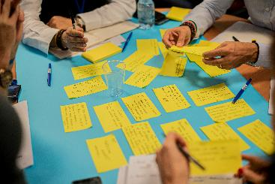
Key Question: How well have the application, assessment, and project monitoring processes worked?
Overall…
Positive experiences – grantees most appreciated the support provided by Groundwork during the fund processes as some found parts challenging or needed some guidance to help complete them.
The networking opportunities – a valuable element for GHCF, with opportunities for improvement so that more grantees can benefit from them. The network could be used more itself to provide information, signposting, learning opportunities and encouragement of local connections and collaboration
Key Question: What have been the challenges or risks to the successful implementation and use of the funding?
Challenges existed for some with the fund processes, during delivery, and with staff and volunteers. Grantees remained flexible and were able to adapt their delivery approaches to address difficulties. Most saw these as a learning opportunity for future work, a positive outlook similar to Wave 1.
Some VCSEs may require further advice and guidance on good practices for organisational management, including training routes, which the GHCF network and the wider Greenwich system could support.

Slide 24
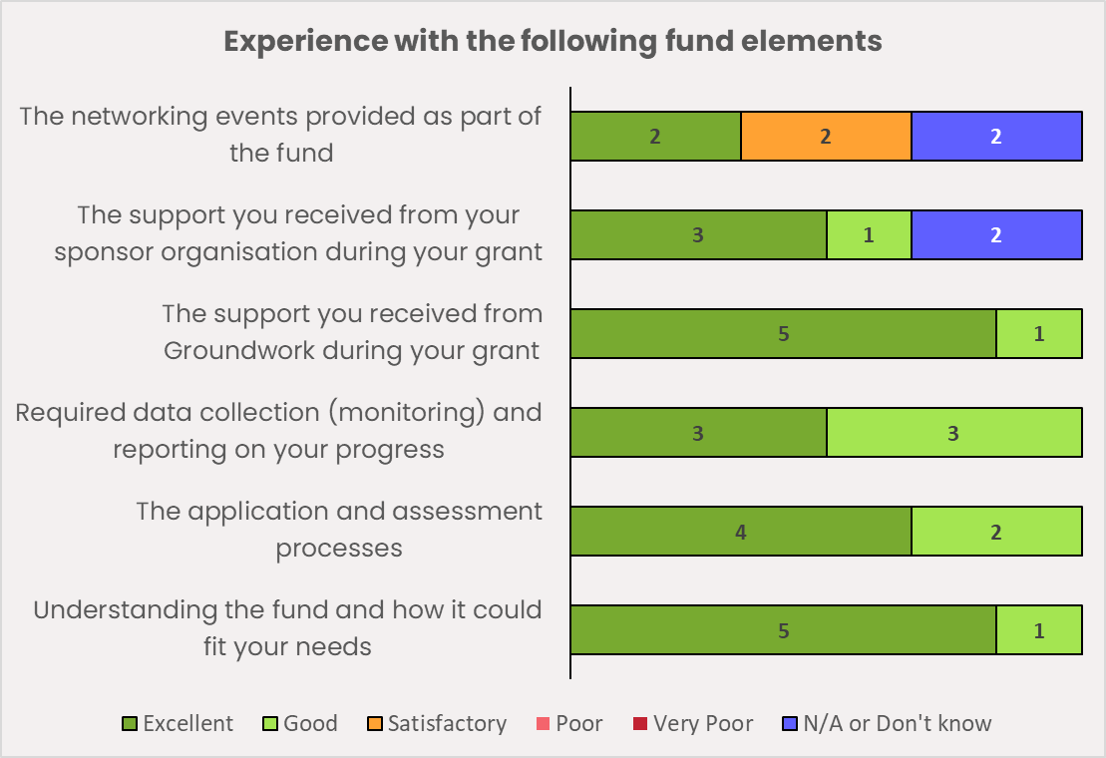
High satisfaction with the GHCF
Micro grantees were new to this wave so it was very important to understand their experiences.
Questionnaire respondents held a very positive view across most fund elements.
Overall satisfaction with the fund – 9.3/10
Groundwork’s support; understanding the fund; and the application, assessment and reporting processes were rated very positively.
A new positive point was the fund’s inclusivity and accessibility, which grantees felt reflected their own efforts and enhanced their approach to reducing health inequalities.
TMicro and Enabling grantees were particularly vocal about the fund’s role and understanding of health inequalities in Greenwich.
“[The Fund has] Clear understanding of both the challenges facing local communities and the types of solutions needed to address them” (Micro, Questionnaire)
Figure 1: Micro grantees’ experience. Source: Evaluation Questionnaire; N=6

Slide 25
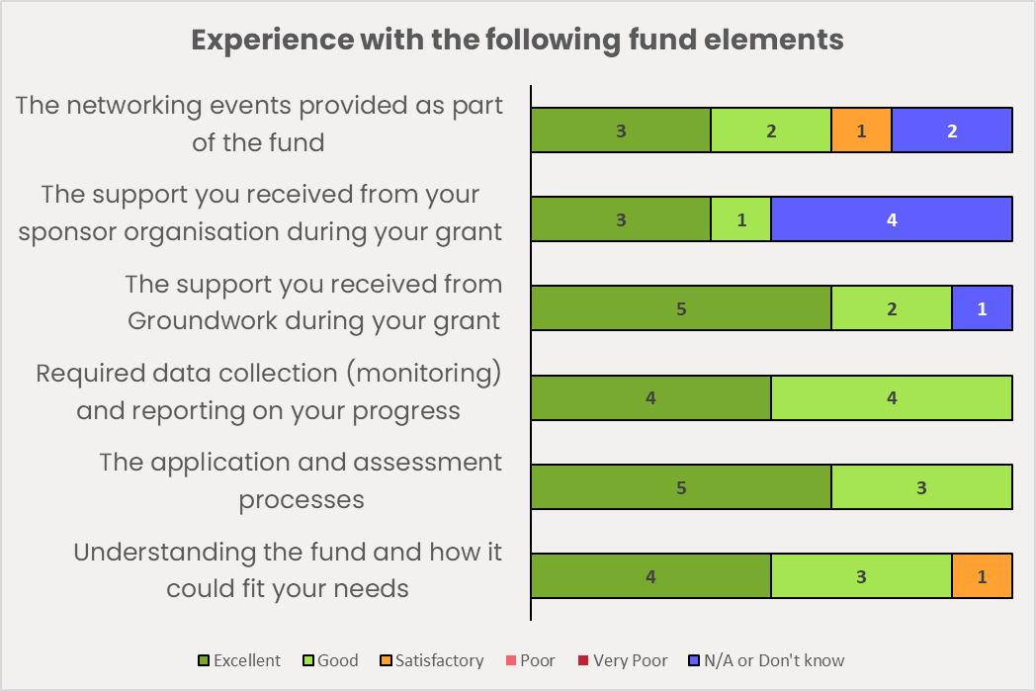
High satisfaction with the GHCF
Enabling strand grantees’ overall satisfaction with the fund was 9.4/10 and their experiences with the fund elements were positive, like in Wave 1.
There were a few less "excellent" ratings than wave 1; but the majority gave “good” and “excellent” ratings of Groundwork’s support and understanding of the fund.
“The Enabling strand recognises that strong infrastructure, safe spaces, and organisational readiness are essential to tackling health inequalities effectively”
(P2 Enabling, Questionnaire)
“Excellent support which is unique to Greenwich, I learnt a lot from other members in the community and the presentations I attended/ the panel.”
(P1, Enabling, Questionnaire)
Figure 2: Enabling grantees’ experience. Source: Evaluation Questionnaire; N=9

Slide 26
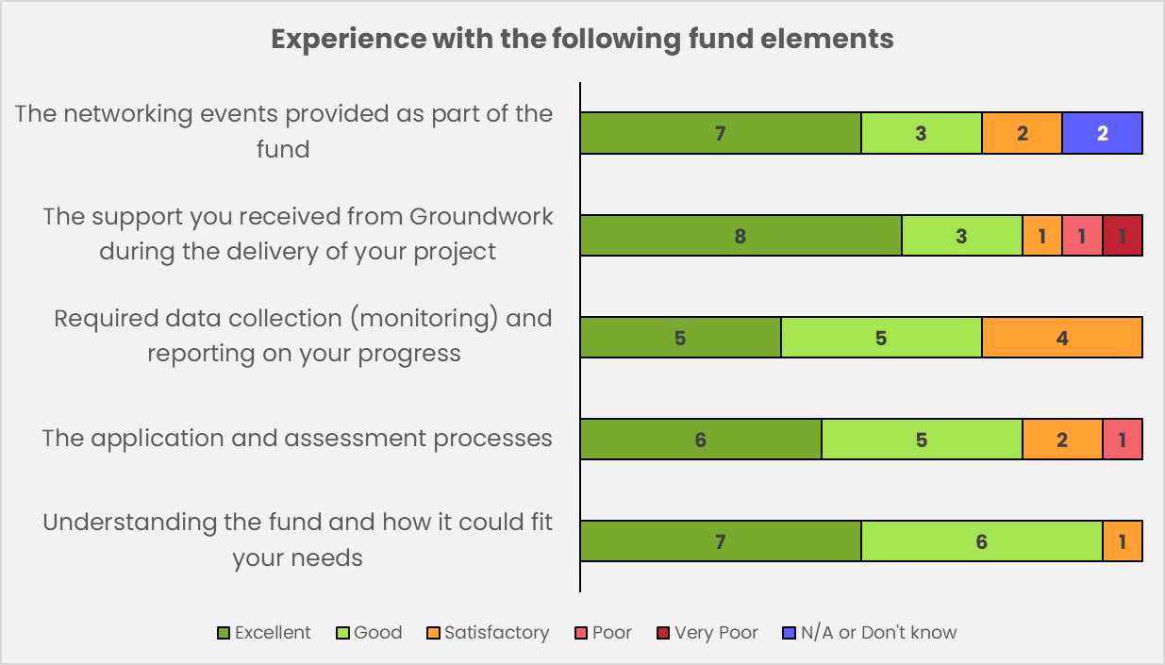
High satisfaction with the GHCF
Delivery grantees showed overall positive feedback of an average 8.9/10 (following an average of 9.4/10 in Wave 1).
Wave 2 shows a slightly broader distribution of feedback.
Figure 3: Delivery grantees’ experience. Source: Evaluation Questionnaire; N=15

Slide 27

Networking opportunities
Those who attended, found the networking to be very positive - grantees appreciated the chance to:
Become more aware of what else is happening in the borough;
Hear how others overcame challenges;
Begin ongoing relationships.
A VCSE collaboration example - opportunity of networking
Two Delivery grantees met at one of the GHCF networking events and have since collaborated with taster sessions delivered by one to reach participants of the other organisation.
“From the networking meeting I met [name]. We collaborated on a mini project delivering singing for breathing sessions for their participants - this was hugely successful with great attendance and participant satisfaction. We are planning on how to build on this next year.”
(Delivery, Questionnaire)
However, some reported that they were not able to attend the times that networking events are held or didn’t have enough notice.
Other grantees found it difficult to find a suitable partner for future work despite their interest.

Slide 28
Challenges through the fund processes -
Difficult to understand some communication and feedback from the fund.
Short time period between project end and next application phase - little time to reflect or seek support in the final stages of the project.
Tight award remit – a few had to fit their project in the fund
Perceptions (whether the case or not) that requesting extensions or other fund-related changes require additional paperwork.
Sometimes the funding timeline can create a risk of service delivery gaps, such as the time between receiving the last funding and the final-report.
Capturing long-term wellbeing improvements, particularly for individuals with more severe mental health conditions. This may require a more reflective evaluation approach.
Challenging to measure impact due to few feedback responses.
How these were overcome -
Contacting Groundwork for support via email and phone;
Sending follow-up communication to collect sufficient feedback responses;
Strengthening approaches to measuring impacts; or embedding into sessions.
Some projects had difficulty in quantifying what was delivered.
It is recommended that qualitative outcomes are recognised and supported, alongside those of a preventative, longer-term nature.

Slide 29
Challenges during delivery -
Low attendance - personal commitments and timing of sessions were occasional barriers to attendance.
Oversubscribed offer - high interest meant the space could feel crowded and sessions disruptive; or people were held on waiting lists.
Communication with partners and partner availability were significant challenges for some grantees.
Maintaining group dynamics and language diversity - often required additional preparation and in-session time.
General challenges - costs for items, training, venues, etc. often rise in the time between application & fund award.
Being awarded less funding than applied for – meaning costs and delivery plans may need to change.
How these were overcome -
Staying adaptive;
Planning for longer periods and keeping the delivery period flexible;
Attending networking events to connect to others, share challenges, gain ideas;
Introducing reminder emails or messages to encourage participants’ RSVPs or via group visibility;
Shifting the curriculum, sessions, and times when needed; and
Maintaining clear communication with participants, and using tools like WhatsApp.

Slide 30
Challenges with staff or volunteers -
Volunteer recruitment/retention and coordination could be initially difficult, whilst attendance and the ability to collect feedback varied.
Partnership with schools comes with its own challenges, for example where school staff need to focus on other tasks and may not be able to provide a consistent point of contact.
For oversubscribed offers, a challenge was a) needing more staff and b) finding a way to support the participants with limited staff numbers and in smaller spaces.
Working with complex groups meant that in some project’s staff/volunteers also needed support and time to reflect between activities, and look after their own wellbeing.
How these were overcome -
One grantee has linked up with Volunteer Centre Greenwich to expand their volunteer base and continue to support their beneficiaries following positive feedback and ask to continue and expand sessions.
Others methods include:
                Increasing promotion and in-community engagement;
                Close collaboration with local networks; and
                Reflecting the community in staff and volunteer members, including direct recruitment or opportunities to support/ join the team at their own pace and development.

Slide 31
Experiences with collaboration
Across the strands, grantees had the opportunity to collaborate with local services, VCSEs, and community groups. This slide presents some of their experiences here.
Examples of benefits:
Examples of challenges:
Examples of how challenges were avoided/ overcome:
15 grantees mentioned positive collaborations
Ongoing communication and close coordination
Free venues
Tight capacity on either end
Strategic planning meetings/ collaborative sessions
Lack of clear communication between parties
Securing future funding
Free items e.g. banners
Longer-term relationships with the intention to apply for joint funding in the future
Aligned goals, increased confidence and more targeted signposting. These changes helped improve how VCSEs address health inequalities.
Time taken to build trusting relationships

Slide 32
Experience with formalised partnerships – Delivery strand
Most Delivery strand grantees who responded to the questionnaire worked with one or more partner (12/15 ). Three felt that partnership was not needed.
The success of the partnership(s) was rated 8 out of 10 on average.
Figure 4: Partnership feedback – Delivery (Evaluation questionnaire, N=15)
Delivery partnerships | How many | Success (out of 10)
Multiple partnerships | 9 | 8.3 (8.5 in wave 1)
One partnership | 3 | 7.0 (9.3 in wave 1)
Did not partner but would have liked to | 0 | n/a
Decided a partnership was not needed | 3
Explored a potential partner but did not proceed | 0
Valuable benefits from multiple partnerships include:
Reaching more participants or more diverse participants (N=7)
Reaching more geographical areas (N=6)
Providing venues, resources or training (N=5)
Those who were able to use multiple partnerships may have already been well connected or established in Greenwich.

Slide 33
4.2 Analysis-
Outcomes and impacts for VCSEs (grantees)
These next nine slides present on one of the key questions of the evaluation: How has the fund impacted the organisations who have participated or been engaged?
It covers:
An overview of outcomes and impacts, highlighting the most common ones.
How grantees reported on what happened/ was planned for after the funding.
What matters for VCSE sustainability.

Slide 34
Overall…
Figure 5: Summary of self-reported outcomes and impacts – VCSE level.
Bolded are high shares of total of the total number of grantees with input data in Wave 2
Outcome or impact | Delivery grantee count (/20) | Enabling grantee count (/17) | Micro grantee count (/10)
Increased knowledge of Health Inequalities (O-1) | 15 | 10 | 8
Reach - more people (O-2) | 14 | 9 | 7
Reach - Support people for better/ longer (O-3) | 16 | 8 | 6
Respond better to health inequality needs (IE-2) | 11 | 9 | 6
Better connected - To RBG & Public Health (O-8) | 11 | 5 | 6
More aware of each other’s work (O-9) | 13 | 4 | 3
Better connected - To communities (O-11) | 17 | 7 | 8
Better connected - To other VCSEs/ orgs (O-17) | 15 | 6 | 5
Collaborations for future (O-10, O-17) | 12 | 10 | 8
Improved facilities & equipment (OE-5) | 2 | 8 | 4
Increased agency for organisation (O-12) | 2 | 1 | 2
Staff & volunteers - More (O-4) | 9 | 11 | 9
Staff & volunteers - more confident (Im-1) | 13 | 10 | 6
Staff & volunteers - more skilled/ knowledgeable (O-5) | 11 | 8 | 9
Staff & volunteers - improved wellbeing (Im-2) | 12 | 6 | 6
More sustainable organisation | 15 | 16 | 9
Seek further GHCF funding (OE-3) | 8 | 12 | 7
The most common, self-reported VCSE impacts were:
Reaching more beneficiaries;
Increased knowledge of health inequalities;
More sustainable VCSE;
Being better connected to communities (Delivery, Micro); and
Gaining more or more skilled or confident staff and volunteers. (Enabling and Micro)

Slide 35
Increased reach and better support
Enabling:
4 grantees – a medium/large increase in the ability to reach more or support for longer/better
Delivery:
12 grantees - a medium/large increase in their ability to reach more local people
14 grantees – a medium/ large increase to support local people for longer/better
Micro:
6 grantees – a medium/large increase to support more or support for longer/better
“The grant also strengthened our ability to support women for longer and in more meaningful ways. Our doulas provided personalised antenatal preparation, advocacy at maternity appointments, emotional support during labour and birth, and continued postnatal care focused on mental wellbeing, bonding, and early parenting confidence.”
(Delivery, Questionnaire)
“We have also grown as an organisation by expanding the way we deliver wellbeing activities. By combining Afro-dance, Boxing for Fitness, wellbeing discussions, and guided meditation, we have developed a more holistic approach that supports both physical and mental health. This experience will continue to influence how we support our community in the future.”
(Delivery, Monitoring Form)
Increased reach typically overlaps with other changes, including:
increased knowledge, increased staff capability and confidence, and increased connection with local communities and other organisations.

Slide 36
Being better connected
Figure 6: Effect of the networking opportunities, Delivery & Enabling grantees (Source: Questionnaire)
Connection between organisations and services, with identified opportunities going forward, has been strongly reported this wave.
Many VCSEs, of different sizes, used their local connections to expand their reach, especially targeting those groups who may be vulnerable and/or harder to reach and to recruit volunteers.
Grantees found that some participants found them through social media and other organisations’ flyers leading to indirect collaboration/referral pathway with others.
Multiple examples were provided on how grantees used informal and formal pathways to be better known in the community and to reach more participants and volunteers.

Slide 37

Connecting better with communities
Connection with communities has often been driven by:
Creating warm, welcoming spaces, often using known community settings (rather than more formal or health focused spaces).
Building on or linking into established community centres and groups to reach those in need.
Building familiarity and trust over time, for participants to feel heard and to be open to the information and guidance
Understanding the needs of those who are less engaged elsewhere, to provide an accessible option that feels safe and appealing.
“The project delivered particularly strong outcomes in creating safe, inclusive spaces where participants could build relationships, share experiences, and access information about skills, employment, and wellbeing support…- The community-led approach, delivered in culturally familiar settings, helped reach women who would not normally engage with mainstream wellbeing services, supporting early prevention of mental health deterioration.” (Micro, Monitoring Form)

Slide 38
Increased capacity
Figure 6: Summary of staff and volunteer training and involvement
Enabling – P1&P2
Delivery – P1
Micro – P2
Upskilling across the strands includes:
Greater awareness of and applying techniques to be accessible to those with additional needs.
Supporting people with vulnerabilities and trauma, including safeguarding.
Creative, reflective practices for wellbeing, incorporated both internally and with beneficiaries.
Understanding how to signpost effectively.
21 M-Form responses
12 M-Form responses
9 M-Form responses
Trained
19 volunteers
23 staff
70 volunteers
26 staff
101 volunteers*
27 staff
111 volunteers
43 staff
17 volunteers
16 staff
45 volunteers**
29 staff
Trained
Involved
Recruited
*one VCSE trained 48 volunteers
**one VCSE recruited 20 volunteers
Like in Wave 1, some of the grants have been able to support people directly into volunteering or upskilled roles to help expand and continue delivery of the activities –
“Importantly, some of our beneficiaries have now started training to become dance instructors so that they can volunteer and help continue the project themselves. This is a significant step toward sustainability, building leadership within the group and creating community role models. It also demonstrates increased confidence, skills development, and ownership of the programme among participants.” (Delivery, Questionnaire)
“We have also invested in educating support staff on inclusive sports delivery, appropriate interaction with people with disabilities, the correct use of specialist equipment, and sourcing accessible resources. This has increased staff confidence, competence, and wellbeing, enabling higher-quality support for users”.
(Delivery, Questionnaire)

Slide 39

Better addressing health inequalities
Overall, there is good emerging evidence that VCSEs are becoming better able to address local health inequalities - in pilots, projects and for future work.
“A key learning is that person-centred, adaptable delivery is essential. Children with SEND have diverse and complex needs, and the ability to adjust activities, communication styles, and environments significantly improves engagement and outcomes. Sensory-informed approaches and structured routines proved particularly effective.” (Delivery, Monitoring Form)
“A key learning is that poor mental wellbeing is rarely a standalone issue; it is closely linked to social isolation, lack of culturally safe spaces, limited access to information, childcare barriers, and restricted opportunities for skills development and employment. Preventing deterioration in mental health therefore requires integrated, community-led approaches rather than single-issue interventions.” (Micro, Questionnaire)
This was driven by:
VCSEs becoming a trusted messenger and signposting beneficiaries to key services; and
VCSEs adapting their services to be more holistic and tailored to the full needs of their users.

Slide 40
Most projects are seeking further funding through GHCF or elsewhere as they rely on that to continue delivering services at no or low cost for local people.
Figure 7: What has happened since the fund ended - All strands (Evaluation Questionnaire)
Most projects are seeking further funding through GHCF or elsewhere - a positive indication on progress being made towards a more resilient VCSE sector.
Enabling grantees have continued to grow and use the connections and skills made during the project. Some also hope to apply for further funding.
The new learning and tools were more likely to be being used by Enabling grantees, more of whom also reported having made new local collaborations since the funding ended.

Slide 41
Most projects are seeking further funding through GHCF or elsewhere - a positive indication on progress being made towards a more resilient VCSE sector.
Figure 7: What has happened since the fund ended - All strands (Evaluation Questionnaire)
Most of the Delivery grantees hope to apply for further funding.
They have continued their projects in some form alongside partnerships and collaborations created from having the grant.
Some Micro grantees reported here that their (pilot) project stopped when the funding ended.

Slide 42
Uncertainties or challenges
VCSE Sustainability
Drivers for future sustainability
As in Wave 1, uncertainty of where new funding would come from and how to manage finances between funding.
Lack of clarity on how partnerships could work for a VCSE, and how to apply effectively for the Delivery strand.
Demand for ongoing support and wider, more consistent networking.
Some felt a lack of local recognition.
Difficult to sustain volunteer capacity.
A strong desire to know about other funding routes and to receive updates from GHCF post-funding.
Clearer alignment between the different funding levels and delivery expectations in future rounds.
Support from Groundwork when moving between strands was greatly appreciated.
Receiving support from other established organisations in Greenwich.
Delivering consistent sessions and aiming to build a base of regular participants, to expand demand and increase take-up for future funding.
Expanding offers to reach new groups or serve different local needs.
“We also valued having the opportunity to meet briefly with fund staff to ask questions about the micro-fund as the Enabling Strand was drawing to a close. This helped us plan the next phase and informed how we collected feedback to shape our development and prepare for the next bid... It provides a helpful bridge between delivery and sustainability.” (Micro, Monitoring Form)

Slide 43
4.3 Analysis-
Outcomes and impacts for beneficiaries
These next five slides present an overview of the outcomes and impacts being delivered to Greenwich’s communities through the grant work.
It covers:
An overview of outcomes and impacts, highlighting the most common ones.
Some specific outcomes emerging for Wave 2, including mental health support and active, healthy living.

Slide 44
Overall…
Figure 8: Summary of self-reported outcomes and impacts – Beneficiary level
Bolded are high shares of total of the total number of grantees with input data in Wave 2
Outcome or impact | Delivery grantee count (/20) | Enabling grantee count (/17) | Micro grantee count (/10)
Access to healthier behaviour resources (O-21) | 15 | 3 | 7
Application of healthier behaviours (O-22) | 14 | - | 5
Increased awareness/ access to long term condition support (O-27) | 10 | - | 3
Increased awareness/ access to mental health support (O-26) | 11 | 2 | 6
Increased participation in groups/ activities (O-20) | 7 | 3 | 3
Capability to support own mental health (O-24) | 16 | 2 | 6
Capability to support own physical health (O-25) | 10 | - | 4
Increase Physical activity (O-28) | 7 | 1 | 3
Increase Physical activity - in children (O-29) | 5 | 2 | 2
Physical health improvements (Im-9) | 8 | 2 | 2
Wellbeing improvements (Im-8) | 18 | 5 | 7
Better nutrition | 10 | 2
Social connection (Im-5) | 19 | 5 | 9
Reduced isolation/ loneliness (Im-6) | 18 | 2 | 6
Increased feelings of safety (Im-7) | 17 | - | 8
The following were reported as outcomes and impacts for beneficiaries of grantee’s work.
This level is less relevant to the Enabling strand, being internally focused.

Slide 45
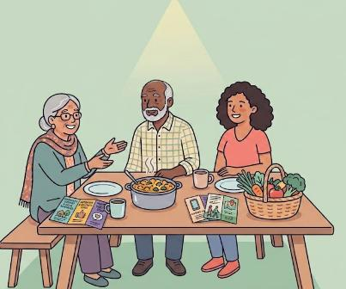
Outcomes and impacts – for Greenwich communities
The following were commonly reported in Wave 2:
1. Increasing social connection
Wave 2 adds further evidence to there being a positive relationship between increasing social connection and helping to address health inequalities.
2. Improvements in subjective wellbeing
In Wave 2, there are more examples of projects improving people’s wellbeing, including children and those with SEND needs.
3. Providing access and awareness of healthier behaviours, support and resources.
For example, providing welcoming, enjoyable ways for participants to gain support and improve their knowledge and health, whilst building bonds with those with similar lived experience.
Notes:
AI images on this slide. Generated with Google Nano Banana Pro 2 for which we have a subscription

Slide 46
Focus 1: Increasing people’s access to mental health support and capability to support their own mental health
Delivery grantees - large impacts:
Improved awareness of and access to support for long-term conditions.
Micro strand Example:
This project provided practical support and methods for a group of individuals to practice together. This included personal and emotional elements for people to self-reflect and connect with others in doing so.
The workshops and foundation course were provided for adults who are at risk of poor mental health, chronic stress, and social isolation.
"Thank you so much for the 8 weeks of beautiful mindfulness and a sanctuary of peace, calm, safety, and acceptance in my week. I cannot begin to express what a difference it has made. I KNOW for a fact I have managed stressful situations better because of it. I feel stronger, more resilient, and quietly powerful to accept what I cannot change, whilst looking forward to when I can.” (Participant testimonial)
Reduced isolation and increased feelings of safety.
Community access to healthy behaviour resources & application of such behaviours.
Increased participation in groups/ activities.
Increases in physical activity for children.
“We have direct contact with multiple Mental Health services… Our staff and volunteers have attended training to support our core groups (rough sleepers and people at risk of homelessness.”
(Delivery, Questionnaire)

Slide 47
Projects recognised underlying needs and factors for stress and low mood
Example 1
“A sub-group of around 60–80 women experienced medium impacts related to mental wellbeing and emotional resilience, including reduced stress, reassurance, and a stronger sense of belonging. This group included women affected by displacement, trauma, domestic challenges, or recent resettlement, for whom culturally safe spaces and peer support played an important preventative role. “(Micro, Questionnaire)
For example, projects have provided:
Access to mental health support to women from migrant communities.
Support to vulnerable pregnant women and new mums.
Tools to take away beyond the sessions to help manage stress and their mental health.
Emotional support for children. (Case Study #1)
Support, for those who may feel isolated, in safe community settings.
Trauma-informed support.
Example 2
One grantee shared the powerful role of understanding individuals’ situations more widely and beyond the sessions. This was an important way to shape their support and build trust and rapport with their beneficiaries, showing interest and praising wider achievements which was well received.
Example 3
One pilot project was delivered for local men of Black Caribbean and African ethnicity, in relaxed settings like barbershops and with food, to facilitate discussions on wellbeing and emotional expression to support personal development and reduce isolation.
It has been successful to offer support and meet-ups away from statutory services and unfamiliar settings to build trust.

Slide 48
Focus 2: Active Healthy Living
More Wave 2 projects prioritised healthy eating or integrated nutritional access into their core programming.
Initiatives included setting up a community pantry and pairing culturally relevant cooking classes with food banks, social connection, and exercise.
Case Study #7 - World of Hope: healthy eating communities – This Wave 2 Case Study presents a positive example of providing culturally relevant cooking sessions and engaging resources for families to take from the classes and events.
“They all changed their eating habits – less sugar, less salt and understood the benefits… They now continue to share this with partners and their families so the education continues. -
It was very positive, the BAME community responded to it. It is always said that they are hard to reach but it was delivered for them, and it was their idea and for their needs. For example, adding carrot into Jollof rice…”
(Delivery, 1:1 discussion)
“Previously we have not thought enough about the food health of young people. Now we think so much more carefully and creatively about what food we have to offer as part of a healthier youth provision in Greenwich.” (Delivery, Questionnaire)
“50 children and young people were regularly informed every half term and school holidays on making healthy food choices. We are partnered with "The Felix Project" - A surplus food redistribution Charity- who provides us with 50 litres of fruits, vegetables and healthy food every half term and school holidays...” (Delivery, Questionnaire)
Projects continue to design and deliver interventions based on the proven link between mental and physical well-being.
Embedding healthy behaviours into welcoming, social community settings remains a primary route to success in Wave 2.

Slide 49
4.4 Analysis -
The Health System in Greenwich
These next six slides present on one of the key questions of the evaluation: What has been the legacy of the fund so far, for changes in the system and neighbourhood delivery?
It covers:
Key themes of health inequalities
Examples of collaboration within the wider system of health in Greenwich
Emerging changes for the system

Slide 50
Key Question: What has been the legacy of the fund so far, for longer-term outcomes and changes in the system and neighbourhood delivery?
Grantees are continuing to enhance their learning about the local health inequalities, with many sharing it with other VCSEs, organisations, and service providers, while some having the opportunity to share it with the council and health practitioners.
Partnerships and referral pathways are emerging strongly, with opportunities to continue to expand them.
Collaborative practices are becoming increasingly more popular, with networking being established to connect organisations of all sizes.
Multiple VCSEs are aiming to increase their awareness of the support available in the borough in order to identify which gaps/where they can fit in and become more well-known themselves.
Grantees identify ‘systems working’ such a referral pathways for reaching more people and supporting them better, ultimately increasing their readiness for future funding and the sustainability of their delivery.
Key Question: For the fund going forward: What are the needs and recommendations to meet its objectives and purpose? What is the rationale and what are the opportunities?
In addition to their positive experiences and learning, grantees also shared opportunities for change and improvement going forward. These have been synthesised into actionable recommendations by DG Cities. Each recommendation is accompanied by a set of learnings, quotes, and examples to put them into context.

Slide 51




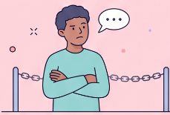

Health Inequalities – Key themes
Themes relevant to Wave 1 and Wave 2:
Themes that emerged more in Wave 2:
Loneliness and isolation remain highly reported, reflecting demands for greater sense of community.
Language barriers & cultural stigma are important underlying concerns and can affect individual wellbeing.
The role of trust matters, with low trust in service provision and opportunities to build it up from within the community.
Keeping physically active and having knowledge on healthy eating and access to healthy food.
Speech and language needs in children.
Lack of awareness amongst participants about available offers in their area.
Notes:
AI images on this slide. Generated with Google Nano Banana Pro 2 for which we have a subscription

Slide 52

Health system collaboration – a mix of practices and strengths/ quality
Partnerships, collaborations, and referral pathways have included :
Specific place-based projects;
NHS/Public Health representatives (e.g. maternity teams) in Greenwich and neighbouring boroughs;
The Job Centre;
Services like Child and Adolescent Mental Health Services (CAMHS), Woolwich Service Users Project (WSUP), and Charlton Athletic Community Trust (CACT);
Libraries, schools, Woolwich leisure centre and GLL (Better); and
Faith-based centres.
Specific community networks like the Greenwich Community Advice Network (GCAN), Be Well Greenwich, and housing associations, were also found to support system coordination and reduce duplication of efforts resulting in collaborative and community-driven local support.
Some grantees showed comprehensive understanding of the fund’s aims to encourage collaboration and cross-system delivery to support an emerging neighbourhood model.
Others could play a critical role in these aims, but may need some support and facilitation to help realise opportunities.
“We initiated and helped establish the Greenwich Community Advice Network (GCAN), bringing together smaller grassroots advice providers to reduce organisational isolation and strengthen collective impact. Through GCAN, we introduced a shared signposting database operating across networks, creating clearer referral pathways, reducing duplication and enabling wraparound support.” Delivery, Questionnaire

Slide 53
Realising system-level collaboration
At the last networking event, DG Cities asked:
How would you like to learn about others and their work in Greenwich on health inequalities?
The value of the GHCF-led in-person networking was highlighted alongside these other ways of support sharing:
Access to 1:1 or small-group peer learning and reflection sessions, instead of just large networking events.
Create a centralised resource hub to help VCSEs map, understand, and connect with peers.
Provide clear, accessible mapping of who delivers local frontline services, support, and community outreach.
Set up dedicated groups or thematic tables (e.g., by demographics, wellbeing areas) to share best practices.
These grantee suggestions are useful to consider.
Overall, on system collaboration:
VCSEs have different skills, backgrounds, and sizes – so adapting the support for VCSEs to collaborate locally and understand how to work within the health and neighbourhood system matters.
Becoming more aware of what others are doing in the borough and increasing a VCSE’s own visibility can improve referral pathways and the support they provide – VCSEs have a key role being ‘familiar faces’ and trusted to communities.

Slide 54
Emerging areas of change
Examples:
Identifying service gaps where partners can offer support.
Building awareness between organisations of different sizes.
Integrating smaller, grassroots groups into a collaborative network to share ideas and solutions.
“This programme has helped us map what support is currently available and identify where there are gaps in provision.” (Delivery, Questionnaire)
“A particularly valuable outcome of the programme has been the professional connections developed with other leaders from different sectors and organisations. These relationships have created an ongoing support network where we can share ideas, challenges, and learning. This peer network has been extremely valuable and provides continued opportunities for collaboration and shared problem-solving beyond the duration of the programme.” (Enabling, P2, Questionnaire)

Slide 55
Emerging areas of change
Examples:
“We feel much better [having] networked into what Greenwich Council is offering to young people and feel that we have more of a seat at the table.” (Delivery, Questionnaire)
“Collaboration within Greenwich has also improved. Through partnerships and community connections, we are better linked into local networks, signposting pathways, and grassroots support. This has allowed us to contribute more meaningfully to borough-wide efforts focused on prevention, early intervention, and improving both mental and physical health outcomes.” (Delivery, Questionnaire)
Being able to take part in meetings and conversations around RBG’s plans for their target groups.
Grantees felt they have enhanced their knowledge on the needs and challenges of their participants and the support needed to reduce those.
The GHCF is also helping in connecting grantees to eachother and to local organisations, which can help referrals and expand their reach.
“The project has also strengthened relationships with Home-Start Greenwich, midwives and other community professionals, by offering the programme through referral pathways and helping us reach families who might otherwise be isolated from support.” (Enabling, P1, Monitoring Form)

Slide 56
5 Recommendations
This is an overview of the recommendations relevant to the GHCF and the funders, Greenwich Public Health, and GHCF grantees; as well as learning from GHCF grantees to date. This covers:
Five of the recommendation areas continue to be relevant from Wave 1.
12 new recommendation points that have emerged during Wave 2

Slide 57
Additional Wave 2 recommendations
Key lessons from Wave 1 still relevant and a priority here
1.1) Greater networking and group opportunities | REC 1.1a) - Support VCSEs with tips on making connections with others REC 1.1b) - Consider networking timing and more effective communications REC 1.1c) - Encourage more grantee-led networking activity and sharing of learning through wider opportunities REC1.1d) - Encourage alumni/post funding networking community and opportunities
1.3) Consistent signposting information | REC 1.3a) - Providing consistent information for the VCSEs on where to access and connect to further support, expertise, and training - for them and their staff. REC 1.3b) - Providing consistent information for the VCSEs on where their beneficiaries can access further support.
1.4) Understanding longevity | The evaluation has built in a light-touch check-in with grantees after the grant.
1.6) Consider grantee-suggested areas of tailored support | REC 1.6a) - Greater clarity on continued access after funding finishes REC 1.6b) - Consider timing between grant funding end and new applications REC 1.6c) - Consistent detail in feedback for when applications are not successful REC 1.6d) - Sharing information on other funding routes, to support VCSEs’ readiness to access more funding and aid their sustainability

Slide 58

For Greenwich Public Health and system stakeholders
In addition, for the ‘Greenwich system’ of health and wellbeing – helping to connect different stakeholders and VCSEs who are addressing health inequalities | REC 3a: To improve the linkages from VCSEs into the wider Greenwich system for volunteering REC 3b: To embed the learning and sharing of the GHCF grantees into the Health Equity focused Public Health strategy and its platform

Slide 59
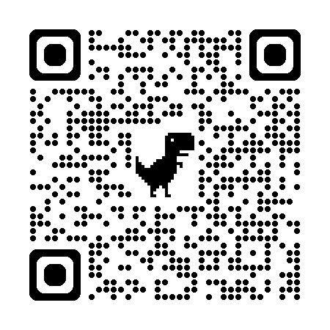
For GHCF grantees
1.5) Share learning, practices and lessons between grantees | For the Funder, GWL, Public Health, and DG Cities to consider how to effectively facilitate and share what works, good examples and areas for attention for grantees to access when it is useful to. For grantees – to participate in these conversations if they’re interested and able and to put forward examples of learning and top tips.
1.2) Other ways to demonstrate and share impact | Examples and wider lessons on what works for data capture should be shared with grantees as part of the suggested learning resources.
These are covered in the Evaluation Learning sessions by DG Cities
Access our webpage here:
https://www.dgcities.com/ghc
To find evaluation learning, support materials and Q&A.
During and after your grant – open to you

Slide 60
For the evaluation going forward
A set of suggestions have been raised for how the evaluation could continue to be (more) accessible or valuable to GHCF, grantees, and the wider system and community in Greenwich.
These will continue to used to design and adapt the Wave 3 evaluation; develop the ongoing monitoring and evaluation learning and support, including from the workshops delivered this summer.
The next steps for the evaluation are to:
Share all evaluation learning to grantees
Share a document outlining the actions taken by DG Cities and GHCF following grantee feedback.
Launch Wave 3 by contacting grantees about their participation, with supporting materials.

